Slide 1
B+-trees
Perhaps the most widely used index ever! CMSC 420 B+-trees were not covered in Spring 2019, yet it is very important that you go through these slides so that you can understand the real story behind <K,V> pairs, the nature of a range query, and why it’s an excellent idea to lower the height of your tree-based index so that you can index into more disk-resident data with a smaller spatial cost in memory!

Slide 2
The true story: <K, V> pairs
So far, we have only cared about storing Comparables such that:
Search is optimized.
Insert is optimized.
Delete is optimized.
We have required that all those elements are Comparables because… we need to compare them.

Slide 3

The true story: <K, V> pairs
So far, we have only cared about storing Comparables such that:
Search is optimized.
Insert is optimized.
Delete is optimized.
We have required that all those elements are Comparables because… we need to compare them.
But does this mean that you can only store things that have a 1-1 mapping with the naturals?

Slide 4
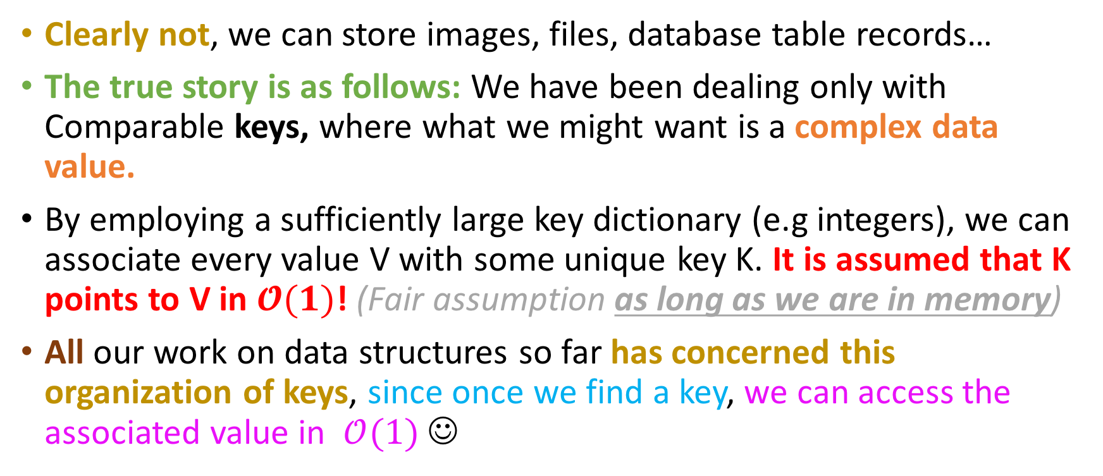
The true story: <K, V> pairs
Clearly not, we can store images, files, database table records…
The true story is as follows: We have been dealing only with Comparable keys, where what we might want is a complex data value.
By employing a sufficiently large key dictionary (e.g integers), we can associate every value V with some unique key K. It is assumed that K points to V in $𝓞(1)$! (Fair assumption as long as we are in memory)
All our work on data structures so far has concerned this organization of keys, since once we find a key, we can access the associated value in $𝒪(1)$ ☺

Slide 5
The true story: <K, V> pairs
30
40
10, 20
8
15
25
35
80

Slide 6
The true story: <K, V> pairs
ID | Name | UID
10 | Jared | 421083
… | … | …
20 | Jackie | 4567676
… | … | …
30 | Michael | 8781230
... | … | …
35 | David | 546867
… | … | …
40 | Raeesha | 2346487
… | … | …
Michael, 8781230
30
Jared, 421083
Raeesha, 2346487
Jackie, 4567676
40
10, 20
8
15
25
35
80
David, 546867

Slide 7
The true story: <K, V> pairs
ID | Name | UID
10 | Jared | 421083
… | … | …
20 | Jackie | 4567676
… | … | …
30 | Michael | 8781230
... | … | …
35 | David | 546867
… | … | …
40 | Raeesha | 2346487
… | … | …
Michael, 8781230
30
Jared, 421083
Raeesha, 2346487
Jackie, 4567676
40
10, 20
8
15
25
35
80
David, 546867
This is what we want (the value)

Slide 8
Relational Databases
ID | Name | UID | Major | Campus resident | Rooms with | Parking space ID | Year
10 | Jared | 421083 | POLI | N | NULL | 89343 | 3
… | … | …
20 | Jackie | 4567676 | NULL | Y | 40 | 243654 | 1
… | … | …
30 | Michael | 8781230 | ENGR | N | NULL | 23465 | 4
... | … | …
35 | David | 546867 | NULL | Y | NULL | NULL | 1
… | … | … | … | … | … | … | …
40 | Raeesha | 2346487 | CS | Y | 20 | NULL | 2
… | … | …

Slide 9
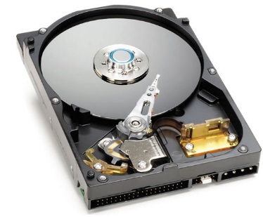
Relational Databases
ID | Name | UID | Major | Campus resident | Rooms with | Parking space ID | Year
10 | Jared | 421083 | POLI | N | NULL | 89343 | 3
… | … | …
20 | Jackie | 4567676 | NULL | Y | 40 | 243654 | 1
… | … | …
30 | Michael | 8781230 | ENGR | N | NULL | 23465 | 4
... | … | …
35 | David | 546867 | NULL | Y | NULL | NULL | 1
… | … | … | … | … | … | … | …
40 | Raeesha | 2346487 | CS | Y | 20 | NULL | 2
… | … | …
This entire table is on disk!

Slide 10
Relational Databases
ID | Name | UID | Major | Campus resident | Rooms with | Parking space ID | Year
10 | Jared | 421083 | POLI | N | NULL | 89343 | 3
… | … | …
20 | Jackie | 4567676 | NULL | Y | 40 | 243654 | 1
… | … | …
30 | Michael | 8781230 | ENGR | N | NULL | 23465 | 4
... | … | …
35 | David | 546867 | NULL | Y | NULL | NULL | 1
… | … | … | … | … | … | … | …
40 | Raeesha | 2346487 | CS | Y | 20 | NULL | 2
… | … | …
This entire table is on disk!
Speaking of disks….

Slide 11

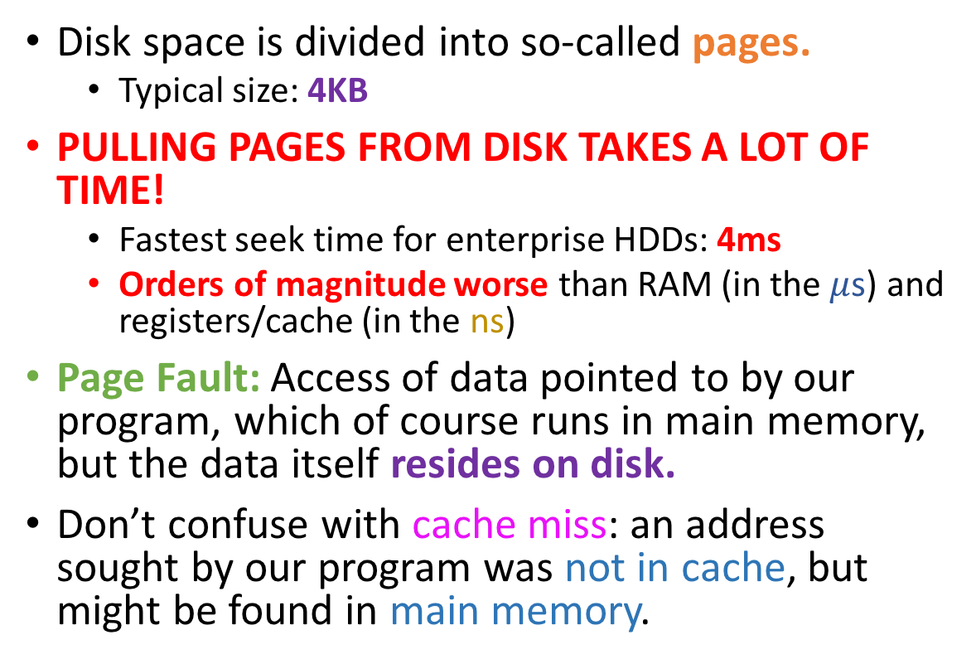
Rotational Hard disks and pages
Disk space is divided into so-called pages.
Typical size: 4KB
PULLING PAGES FROM DISK TAKES A LOT OF TIME!
Fastest seek time for enterprise HDDs: 4ms
Orders of magnitude worse than RAM (in the $μ$s) and registers/cache (in the ns)
Page Fault: Access of data pointed to by our program, which of course runs in main memory, but the data itself resides on disk.
Don’t confuse with cache miss: an address sought by our program was not in cache, but might be found in main memory.

Slide 12
Rotational Hard disks and pages
Operating Systems allow applications to allocate buffers for reading and writing EXACTLY PAGE_SIZE kilobytes big.
Usually, PAGE_SIZE=4KB
The application can then do whatever it needs with the data. If a change of the data needs to persist on disk, the entire page will be flushed to disk.
Even if exactly one byte was changed.
Beneficial for buffers to persist in memory if possible (leverage locality), to avoid going back to disk.

Slide 13
Rotational Hard disks and pages
Disk fragmentation: Under or over-utilization of disk pages by an application.
Under-utilization: pages are largely empty and space is wasted.
Over-utilization: the application takes up a lot of new hard disk pages, and indices have to be updated (this costs time)
We will not talk about how we can control and optimize disk space (beyond scope).

Slide 14
Example Queries
TABLE STUDENTS
ID | Name | UID | Major | Campus resident | Rooms with | Parking space ID | Year
10 | Jared | 421083 | POLI | N | NULL | 89343 | 3
… | … | …
20 | Jackie | 4567676 | NULL | Y | 40 | 243654 | 1
… | … | …
30 | Michael | 8781230 | ENGR | N | NULL | 23465 | 4
... | … | …
35 | David | 546867 | NULL | Y | NULL | NULL | 1
… | … | … | … | … | … | … | …
40 | Raeesha | 2346487 | CS | Y | 20 | NULL | 2
… | … | …
Show me all fields from all records in the table . (SELECT * from STUDENTS)

Slide 15
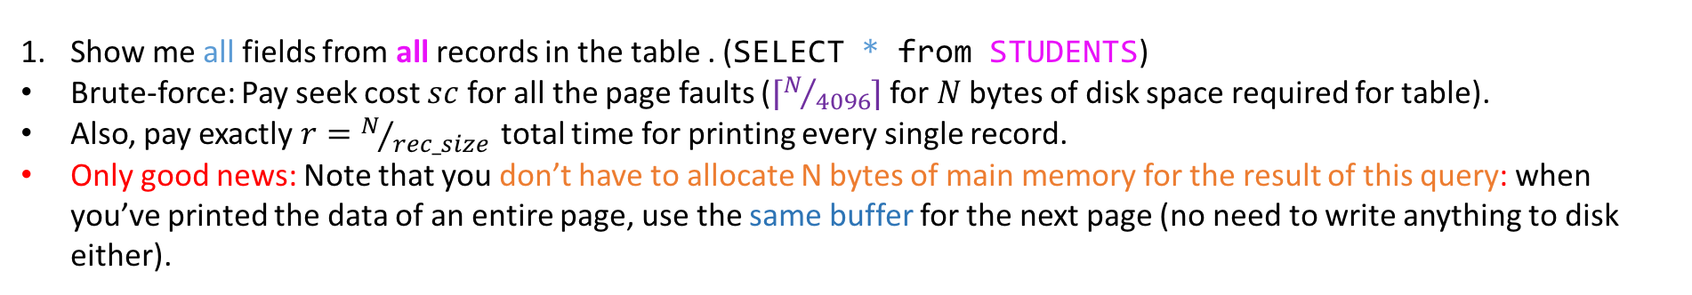
Example Queries
TABLE STUDENTS
ID | Name | UID | Major | Campus resident | Rooms with | Parking space ID | Year
10 | Jared | 421083 | POLI | N | NULL | 893439 | 3
… | … | …
20 | Jackie | 4567676 | NULL | Y | 40 | 243654 | 1
… | … | …
30 | Michael | 8781230 | ENGR | N | NULL | 234656 | 4
... | … | …
35 | David | 546867 | NULL | Y | NULL | NULL | 1
… | … | … | … | … | … | … | …
40 | Raeesha | 2346487 | CS | Y | 20 | NULL | 2
… | … | …
4KB
4KB
4KB
Show me all fields from all records in the table . (SELECT * from STUDENTS)
Brute-force: Pay seek cost $sc$ for all the page faults ($⌈N/{4096}⌉$ for $N$ bytes of disk space required for table).
Also, pay exactly $r=N/{rec_size }$ total time for printing every single record.
Only good news: Note that you don’t have to allocate N bytes of main memory for the result of this query: when you’ve printed the data of an entire page, use the same buffer for the next page (no need to write anything to disk either).

Slide 16
Example Queries
TABLE STUDENTS
ID | Name | UID | Major | Campus resident | Rooms with | Parking space ID | Year
10 | Jared | 421083 | POLI | N | NULL | 893439 | 3
… | … | …
20 | Jackie | 4567676 | NULL | Y | 40 | 243654 | 1
… | … | …
30 | Michael | 8781230 | ENGR | N | NULL | 234656 | 4
... | … | …
35 | David | 546867 | NULL | Y | NULL | NULL | 1
… | … | … | … | … | … | … | …
40 | Raeesha | 2346487 | CS | Y | 20 | NULL | 2
… | … | …
CAN WE DO BETTER?
Yes
No
Show me all fields from all records in the table . (SELECT * from STUDENTS)
Brute-force: Pay seek cost $sc$ for all the page faults ($⌈N/{4096}⌉$ for $N$ bytes of disk space required for table).
Also, pay exactly $r=N/{rec_size }$ total time for printing every single record.
Only good news: Note that you don’t have to allocate N bytes of main memory for the result of this query: when you’ve printed the data of an entire page, use the same buffer for the next page (no need to write anything to disk either).

Slide 17

Example Queries
TABLE STUDENTS
ID | Name | UID | Major | Campus resident | Rooms with | Parking space ID | Year
10 | Jared | 421083 | POLI | N | NULL | 893439 | 3
… | … | …
20 | Jackie | 4567676 | NULL | Y | 40 | 243654 | 1
… | … | …
30 | Michael | 8781230 | ENGR | N | NULL | 234656 | 4
... | … | …
35 | David | 546867 | NULL | Y | NULL | NULL | 1
… | … | … | … | … | … | … | …
40 | Raeesha | 2346487 | CS | Y | 20 | NULL | 2
… | … | …
CAN WE DO BETTER?
Yes
No
This query asks for everything and anything!
Sooner or later, we will pay the price!
Even if you build a Red-Black Tree over IDs… you still have to scan all pages!
Show me all fields from all records in the table . (SELECT * from STUDENTS)
Brute-force: Pay seek cost $sc$ for all the page faults ($⌈N/{4096}⌉$ for $N$ bytes of disk space required for table).
Also, pay exactly $r=N/{rec_size }$ total time for printing every single record.
Only good news: Note that you don’t have to allocate N bytes of main memory for the result of this query: when you’ve printed the data of an entire page, use the same buffer for the next page (no need to write anything to disk either).

Slide 18
Example Queries
TABLE STUDENTS
ID | Name | UID | Major | Campus resident | Rooms with | Parking space ID | Year
10 | Jared | 421083 | POLI | N | NULL | 893439 | 3
… | … | …
20 | Jackie | 4567676 | NULL | Y | 40 | 243654 | 1
… | … | …
30 | Michael | 8781230 | ENGR | N | NULL | 234656 | 4
... | … | …
35 | David | 546867 | NULL | Y | NULL | NULL | 1
… | … | … | … | … | … | … | …
40 | Raeesha | 2346487 | CS | Y | 20 | NULL | 2
… | … | …
Show me all fields from students ID is between 740 and 1043. (SELECT * from STUDENTS WHERE ID >=740 AND ID <= 1043)

Slide 19
Example Queries
TABLE STUDENTS
ID | Name | UID | Major | Campus resident | Rooms with | Parking space ID | Year
10 | Jared | 421083 | POLI | N | NULL | 893439 | 3
… | … | …
20 | Jackie | 4567676 | NULL | Y | 40 | 243654 | 1
… | … | …
30 | Michael | 8781230 | ENGR | N | NULL | 234656 | 4
... | … | …
35 | David | 546867 | NULL | Y | NULL | NULL | 1
… | … | … | … | … | … | … | …
40 | Raeesha | 2346487 | CS | Y | 20 | NULL | 2
… | … | …
CAN WE DO BETTER NOW?
Yes
Foreshadowing does, like, nothing for me
Show me all fields from students ID is between 740 and 1043. (SELECT * from STUDENTS WHERE ID >=740 AND ID <= 1043)

Slide 20
Example Queries
TABLE STUDENTS
We will need an index over IDs!
ID | Name | UID | Major | Campus resident | Rooms with | Parking space ID | Year
10 | Jared | 421083 | POLI | N | NULL | 893439 | 3
… | … | …
20 | Jackie | 4567676 | NULL | Y | 40 | 243654 | 1
… | … | …
30 | Michael | 8781230 | ENGR | N | NULL | 234656 | 4
... | … | …
35 | David | 546867 | NULL | Y | NULL | NULL | 1
… | … | … | … | … | … | … | …
40 | Raeesha | 2346487 | CS | Y | 20 | NULL | 2
… | … | …
Yes
Foreshadowing does, like, nothing for me
Show me all fields from students ID is between 740 and 1043. (SELECT * from STUDENTS WHERE ID >=740 AND ID <= 1043)

Slide 21
Warmup Exercise
Take 10 to implement the void method
rangeSearch(Node n, int min, int max, List<Integer> list),
such that we can perform range search on this BST!
40
12
58
7
24
72
65
62

Slide 22
Warmup Exercise
Take 10 to implement the void method
rangeSearch(Node n, int min, int max, List<Integer> list),
such that we can perform range search on this BST!
40
[12, 65]
58
12
7
24
72
65
62

Slide 23
Warmup Exercise
Take 10 to implement the void method
rangeSearch(Node n, int min, int max, List<Integer> list),
such that we can perform range search on this BST!
40
[12, 12]
58
12
7
24
72
65
62

Slide 24
Warmup Exercise
Take 10 to implement the void method
rangeSearch(Node n, int min, int max, List<Integer> list),
such that we can perform range search on this BST!
40
[11, 12]
58
12
(11 is not a key in this tree…)
7
24
72
65
62

Slide 25

Warmup Exercise
Take 10 to implement the void method
rangeSearch(Node n, int min, int max, List<Integer> list),
such that we can perform range search on this BST!
40
[70, 20]
12
58
Just throw your favorite exception!
7
24
72
65
62

Slide 26
Warmup Exercise
Take 10 to implement the void method
rangeSearch(Node n, int min, int max, List<Integer> list),
such that we can perform range search on this BST!
Example Call: ArrayList<T> list = new ArrayList(); rangeSearch(root, min, max, list)
40
12
58
7
24
72
65
62

Slide 27
Warmup Exercise
Take 10 to implement the void method
rangeSearch(Node n, int min, int max, List<Integer> list),
such that we can perform range search on this BST!
// This will fail if min and max are null, but whatever
private void rangeSearch(Node n, T min, T max, List<T> list){ assert min.compareTo(max) <= 0 : "Min ought to be smaller than or equal to max.";
if(n == null) return; if(n.key.compareTo(min) > 0 && n.key.compareTo(max) < 0){ rangeSearch(n.left, min, n.key, list); list.add(n.key); rangeSearch(n.right, n.key, max, list); } else if(n.key.compareTo(min) == 0) { list.add(n.key); rangeSearch(n.right, n.key, max, list); } else if(n.key.compareTo(min) < 0) { rangeSearch(n.right, n.key, max, list); } else if(n.key.compareTo(max) == 0 ) { rangeSearch(n.left, min, n.key, list); list.add(n.key); // ! If you want the range sorted, the addition should be after the recursive call. } else if(n.key.compareTo(max) > 0 ) { rangeSearch(n.left, min, n.key, list); } }
40
12
58
7
24
72
65
62

Slide 28
Key-Value Dictionaries are database indices
We can do this with a BST. We know how to do range search, so…
Let’s assume that we build our index as a BST…

Slide 29
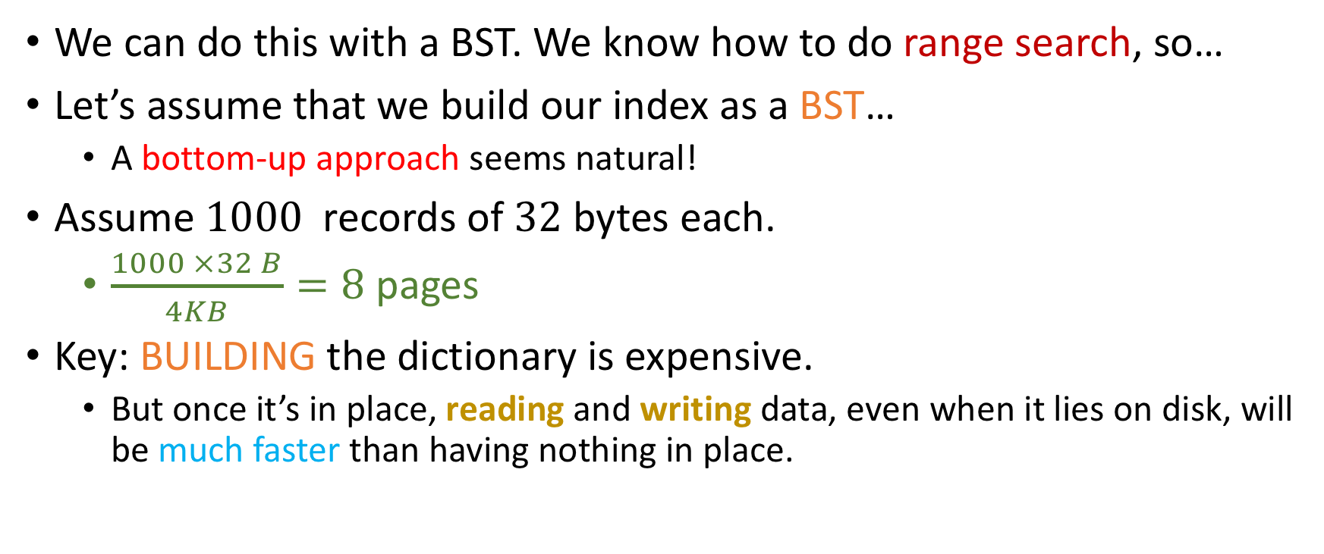
Key-Value Dictionaries are database indices
We can do this with a BST. We know how to do range search, so…
Let’s assume that we build our index as a BST…
A bottom-up approach seems natural!
Assume $1000$ records of $32$ bytes each.
$\frac{1000 ×32 B}{4KB}=8$ pages
Key: BUILDING the dictionary is expensive.
But once it’s in place, reading and writing data, even when it lies on disk, will be much faster than having nothing in place.

Slide 30
Building a BST index, bottom-up
0
126
251
376
501
626
751
876

Slide 31
Building a BST index, bottom-up
All of those are on disk!
0
126
251
376
501
626
751
876

Slide 32
Building a BST index, bottom-up
To separate the disk pages, we need an appropriate separator.
Answer: Take the average of the first and last ids of every page!
Other values could also work, e.g median. Average is just easy.
126.5
375.5
625.5
875.5
0
126
127
250
251
375
376
500
501
625
626
750
751
875
876
1000

Slide 33
Building a BST index, bottom-up
To separate the disk pages, we need an appropriate separator.
Answer: Take the average of the first and last ids of every page!
Other values could also work, e.g median. Average is just easy.
These are in memory!
126.5
375.5
625.5
875.5
0
126
127
250
251
375
376
500
501
625
626
750
751
875
876
1000

Slide 34
Building a BST index, bottom-up
We can repeat the exact same process for the rest of the nodes!
500.75
251
750.5
126.5
375.5
625.5
875.5
0
126
127
250
251
375
376
500
501
625
626
750
751
875
876
1000

Slide 35
Some code that does this
class Node { T key;
Node left, right;
}
enqueue
Node
Node
Node
Node
Node
dequeue
FifoQueue<Node<T>> q = new FifoQueue<T>();
nodes.forEach(q::enqueue); // Assume that all nodes are in some Iterable structure
while(q.size() > 2){
Node n1 = q.dequeue(), n2 = q.dequeue();
q.enqueue(new Node((n1.key + n2.key) / 2, n1, n2));
} // At this point we only have two subtrees and have to connect them to a root node (q.size() == 2 is an invariant)
Node n1 = q.dequeue(), n2 = q.dequeue();
Node root = new Node((n1.key + n2.key) / 2, n1, n2));
Node
FIFOQueue<Node<T>>

Slide 36
Using our index
SELECT * from STUDENTS WHERE ID > 250 AND ID <= 700
500.75
251
750.5
126.5
375.5
625.5
875.5
0
126
127
250
251
375
376
500
501
625
626
750
751
875
876
1000

Slide 37
Using our index
SELECT * from STUDENTS WHERE ID > 250 AND ID <= 700
500.75
251
750.5
126.5
375.5
625.5
875.5
0
126
127
250
251
375
376
500
501
625
626
750
751
875
876
1000

Slide 38
Using our index
SELECT * from STUDENTS WHERE ID > 250 AND ID <= 700
500.75
Pull this to memory
251
750.5
126.5
375.5
625.5
875.5
0
126
127
250
251
375
376
500
501
625
626
750
751
875
876
1000

Slide 39
Using our index
SELECT * from STUDENTS WHERE ID > 250 AND ID <= 700
500.75
Pull this to memory
251
750.5
126.5
375.5
625.5
875.5
Fetch next page…
0
126
127
250
251
375
376
500
501
625
626
750
751
875
876
1000

Slide 40
Using our index
SELECT * from STUDENTS WHERE ID > 250 AND ID <= 700
500.75
Pull this to memory
251
750.5
126.5
375.5
625.5
875.5
Fetch next page…
0
126
127
250
251
375
376
500
501
625
626
750
751
875
876
1000

Slide 41
Using our index
SELECT * from STUDENTS WHERE ID > 250 AND ID <= 700
500.75
Pull this to memory
251
750.5
126.5
375.5
625.5
875.5
Fetch next page…
0
126
127
250
251
375
376
500
501
625
626
750
751
875
876
1000

Slide 42


Using our index
SELECT * from STUDENTS WHERE ID > 250 AND ID <= 700
Seriously? I have to pay $O(\log_{2}{n)}$ every time I seek a new page for my query?
500.75
Pull this to memory
251
750.5
126.5
375.5
625.5
875.5
Fetch next page…
0
126
127
250
251
375
376
500
501
625
626
750
751
875
876
1000

Slide 43

Using our index
SELECT * from STUDENTS WHERE ID > 250 AND ID <= 700
Store pointers on disk!
Look up C’s FILE*(“File-star”) for an example of a very low-level pointer to a file.
500.75
251
750.5
126.5
375.5
625.5
875.5
126
127
250
251
625
….. 700
… 750
751
0
375
376
500
501
626
875
876
1000

Slide 44
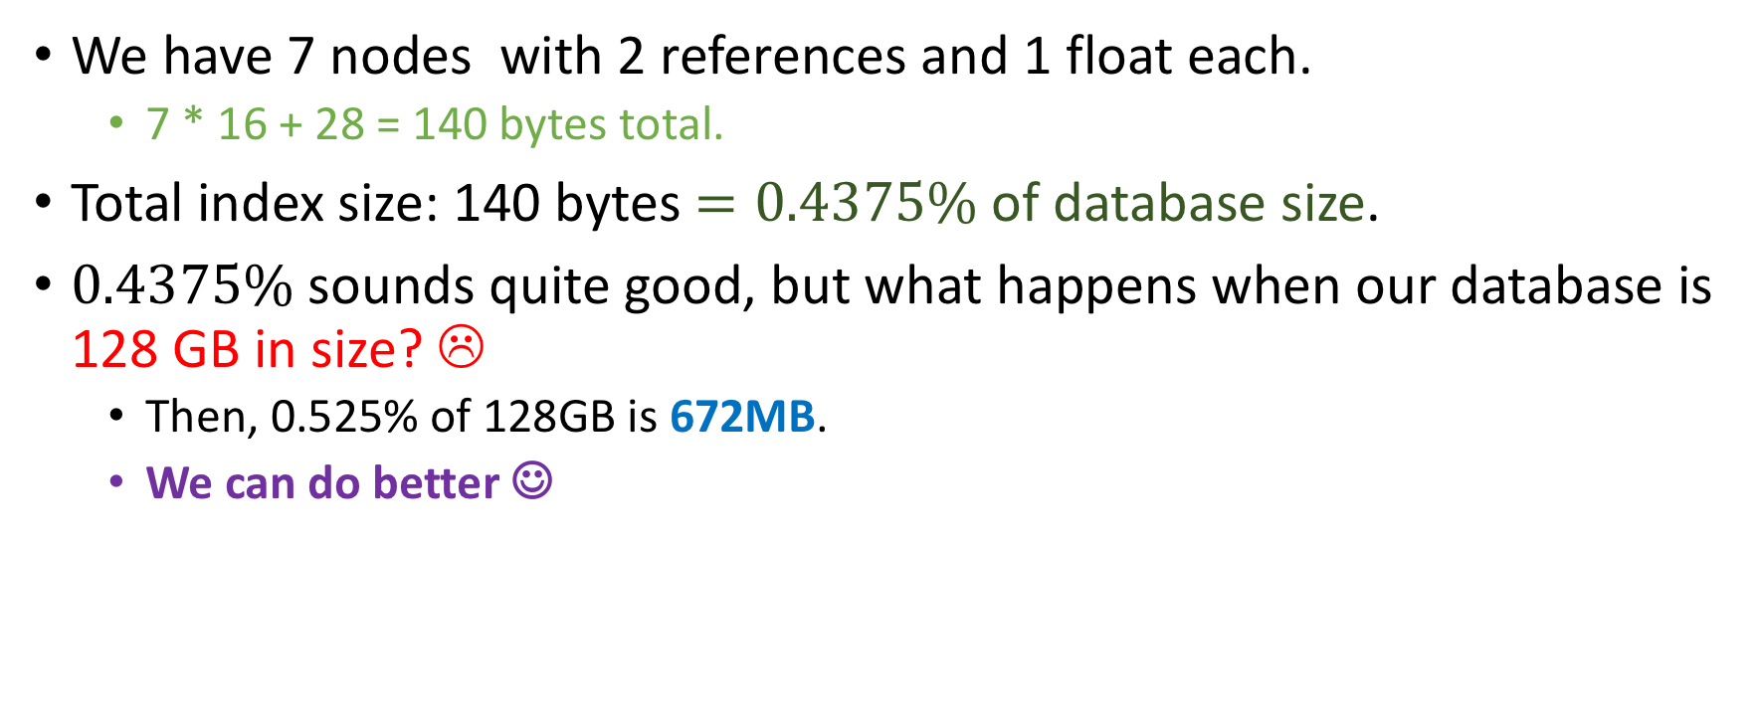
Space Analysis (Main Memory)
We have 7 nodes with 2 references and 1 float each.
7 * 16 + 28 = 140 bytes total.
Total index size: 140 bytes $=0.4375\%$ of database size.
$0.4375\%$ sounds quite good, but what happens when our database is 128 GB in size? ☹
Then, 0.525% of 128GB is 672MB.
We can do better ☺

Slide 45
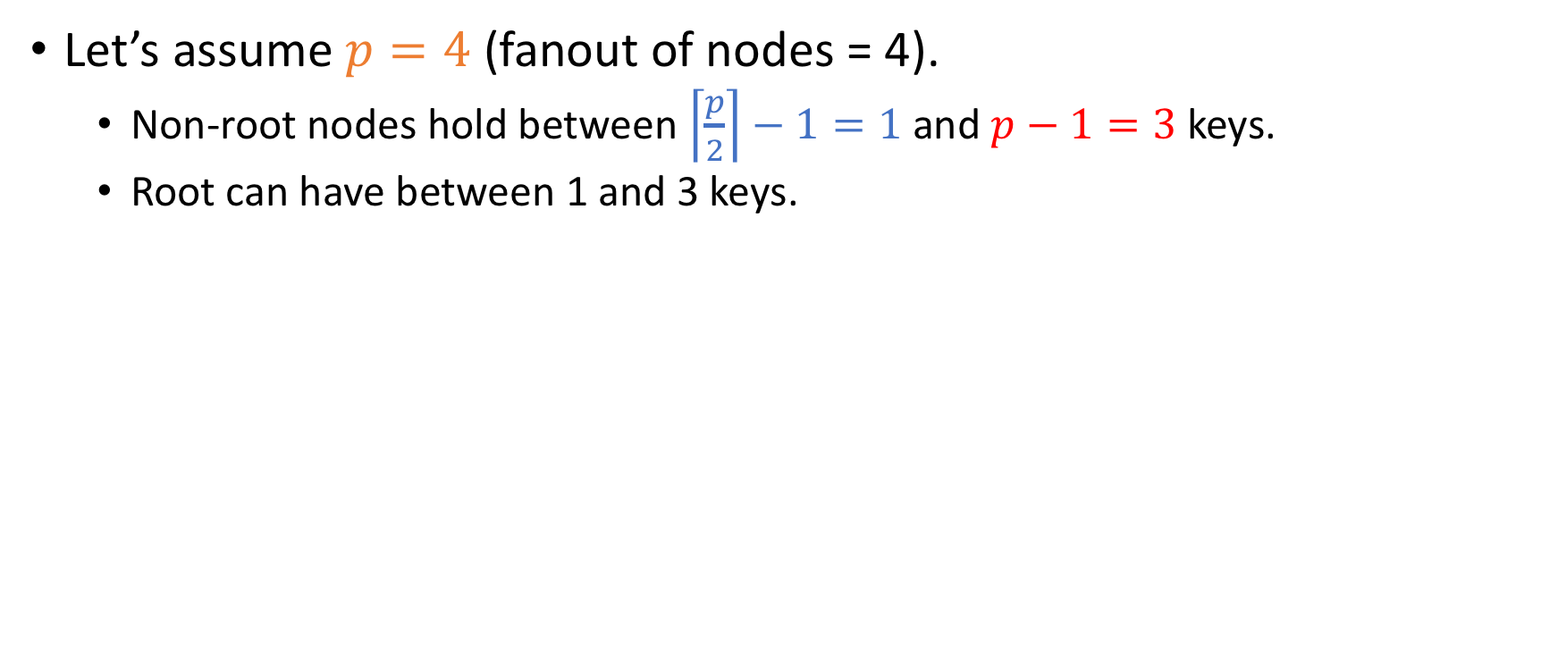
Example of our new index
Let’s assume $p=4$ (fanout of nodes = 4).
Non-root nodes hold between $\left\lceil \frac{p}{2}\right\rceil −1=1$ and $p−1=3$ keys.
Root can have between 1 and 3 keys.

Slide 46
Example of our new index
Then, we can build the following index over the same data:

Slide 47
Example of our new index
Then, we can build the following index over the same data:
0
126
127
250
251
375
376
500
501
625
626
750
751
875
876
1000

Slide 48
Example of our new index
Then, we can build the following index over the same data:
500.5
* | *
126.5 | 250.5 | 375.5
625.5 | 750.5 | 875.5
* | * | * | *
* | * | * | *
0
126
127
250
251
375
376
500
501
625
626
750
751
875
876
1000

Slide 49
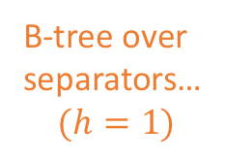
Example of our new index
Then, we can build the following index over the same data:
500.5
* | *
B-tree over separators…
$$(h=1)$$
126.5 | 250.5 | 375.5
625.5 | 750.5 | 875.5
* | * | * | *
* | * | * | *
0
126
127
250
251
375
376
500
501
625
626
750
751
875
876
1000

Slide 50
Example of our new index
Then, we can build the following index over the same data:
Both the memory and the give us a B⁺-tree (“B – plus tree”) index
500.5
* | *
B-tree over separators…
$$(h=1)$$
126.5 | 250.5 | 375.5
625.5 | 750.5 | 875.5
* | * | * | *
* | * | * | *
0
126
127
250
251
375
376
500
501
625
626
750
751
875
876
1000

Slide 51
Comparison to BST index
Spatial Cost of B⁺- Tree index = 2 * leaf_node_cost + root_cost
Leaf_node_cost = 3 * sizeof(float) + 4 *sizeof(ref) = 3 * 4 + 4 * 8 = 44 bytes
root_cost = sizeof(float) + 2 * sizeof(ref) = 4 + 16 = 20 bytes
So Spatial Cost = 2 * 44 + 20 = 104 bytes < 140 bytes which was the cost for the BST index!
Wait till you see the spatial benefit in larger databases…

Slide 52
The power of B⁺-trees
Suppose my page size is 4KB (standard for most commercial PCs)

Slide 53
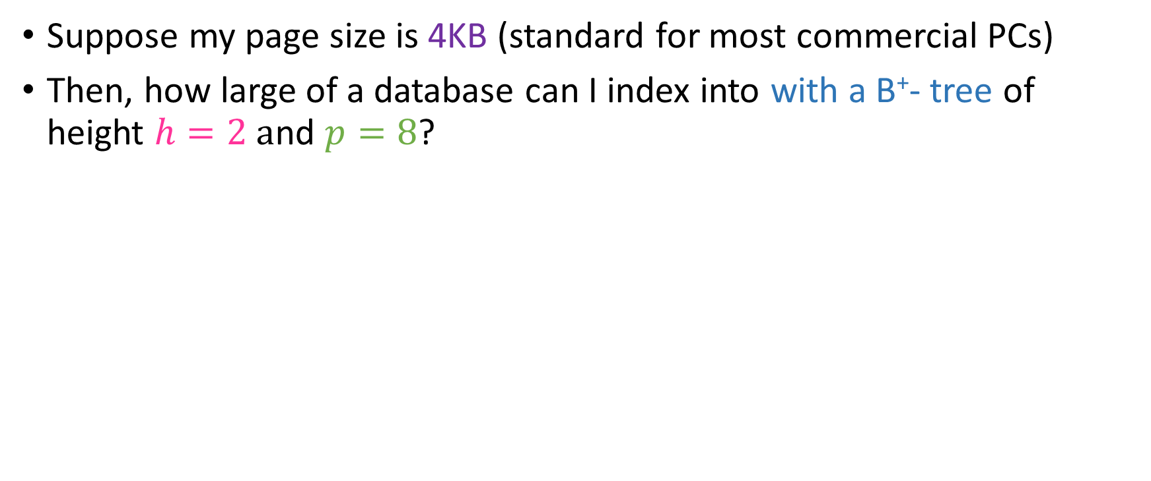
The power of B⁺-trees
Suppose my page size is 4KB (standard for most commercial PCs)
Then, how large of a database can I index into with a B⁺- tree of height $h=2 a$nd $p=8$?

Slide 54
The power of B⁺-trees
Suppose my page size is 4KB (standard for most commercial PCs)
Then, how large of a database can I index into with a B⁺- tree of height $h=2 a$nd $p=8$?
The B-Tree component…

Slide 55

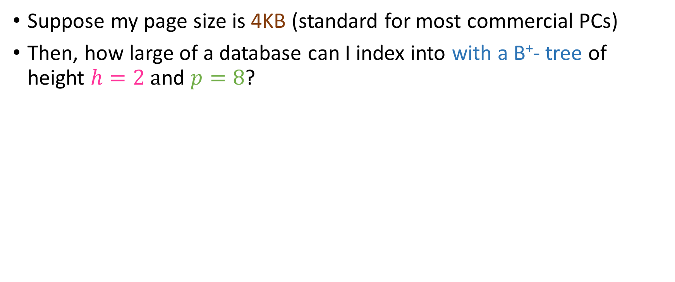
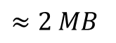
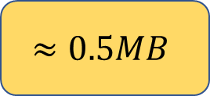
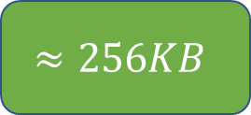
The power of B⁺-trees
Suppose my page size is 4KB (standard for most commercial PCs)
Then, how large of a database can I index into with a B⁺- tree of height $h=2 a$nd $p=8$?
$$≈128KB$$
$$≈256KB$$
$$≈0.5MB$$
$$≈2 MB$$

Slide 56
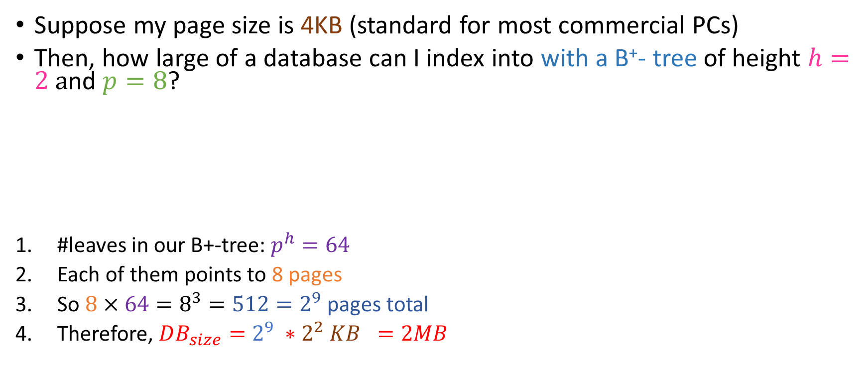
The power of B⁺-trees
Suppose my page size is 4KB (standard for most commercial PCs)
Then, how large of a database can I index into with a B⁺- tree of height $h=2 a$nd $p=8$?
#leaves in our B+-tree: $p^{h}=64$
Each of them points to 8 pages
So $8×64=8^{3}=512=2^{9}$ pages total
Therefore, $DB_{size}=2^{9} ∗2^{2} KB =2MB$
$$≈128KB$$
$$≈256KB$$
$$≈0.5MB$$
$$≈2 MB$$

Slide 57

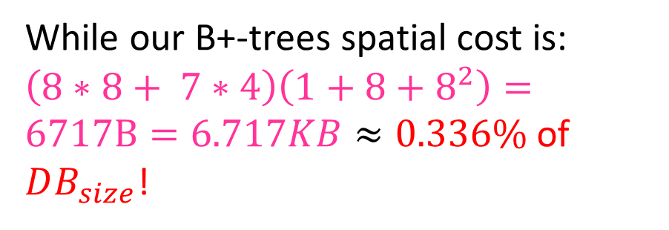
The power of B⁺-trees
Suppose my page size is 4KB (standard for most commercial PCs)
Then, how large of a database can I index into with a B⁺- tree of height $h=2 a$nd $p=8$?
#leaves in our B+-tree: $p^{h}=64$
Each of them points to 8 pages
So $8×64=8^{3}=512=2^{9}$ pages total
Therefore, $DB_{size}=2^{9} ∗2^{2} KB =2MB$
$$≈128KB$$
$$≈256KB$$
$$≈0.5MB$$
$$≈2 MB$$
While our B+-trees spatial cost is: $\left(8∗8+ 7∗4\right)\left(1+8+8^{2}\right)=6717B=6.717KB≈0.336\%$ of $DB_{size}$!

Slide 58
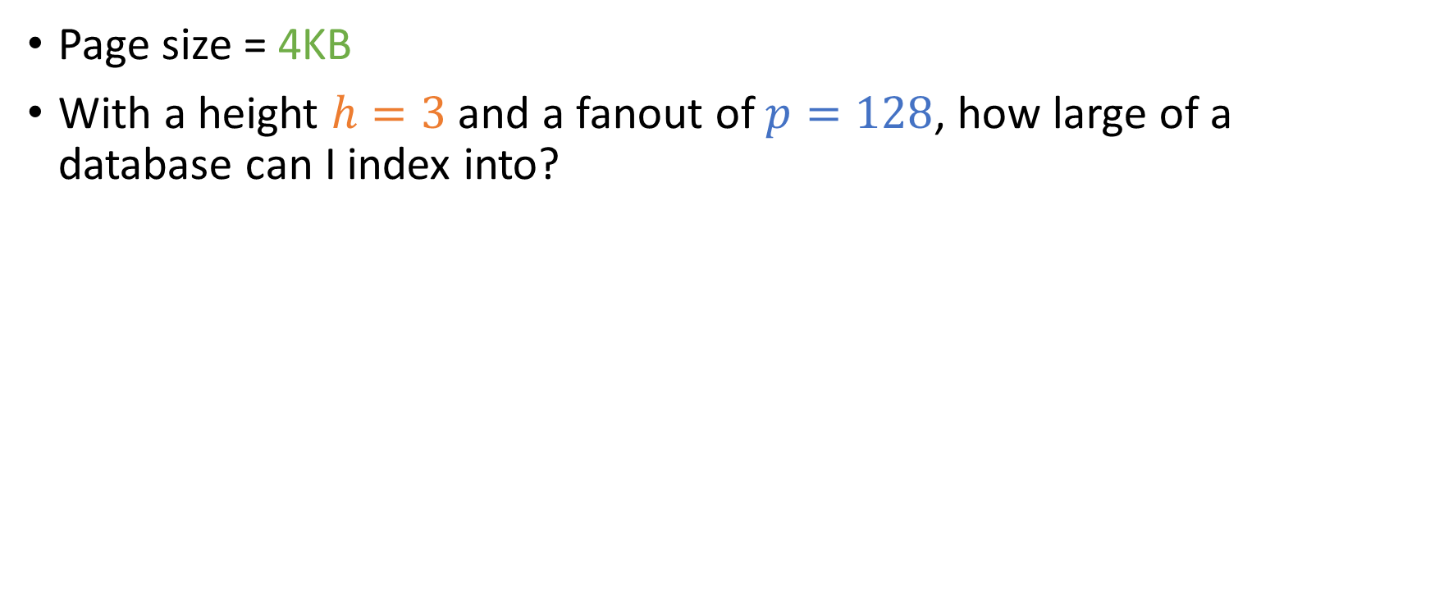
Similar exercise
Page size = 4KB
With a height $h=3$ and a fanout of $p=128$, how large of a database can I index into?

Slide 59
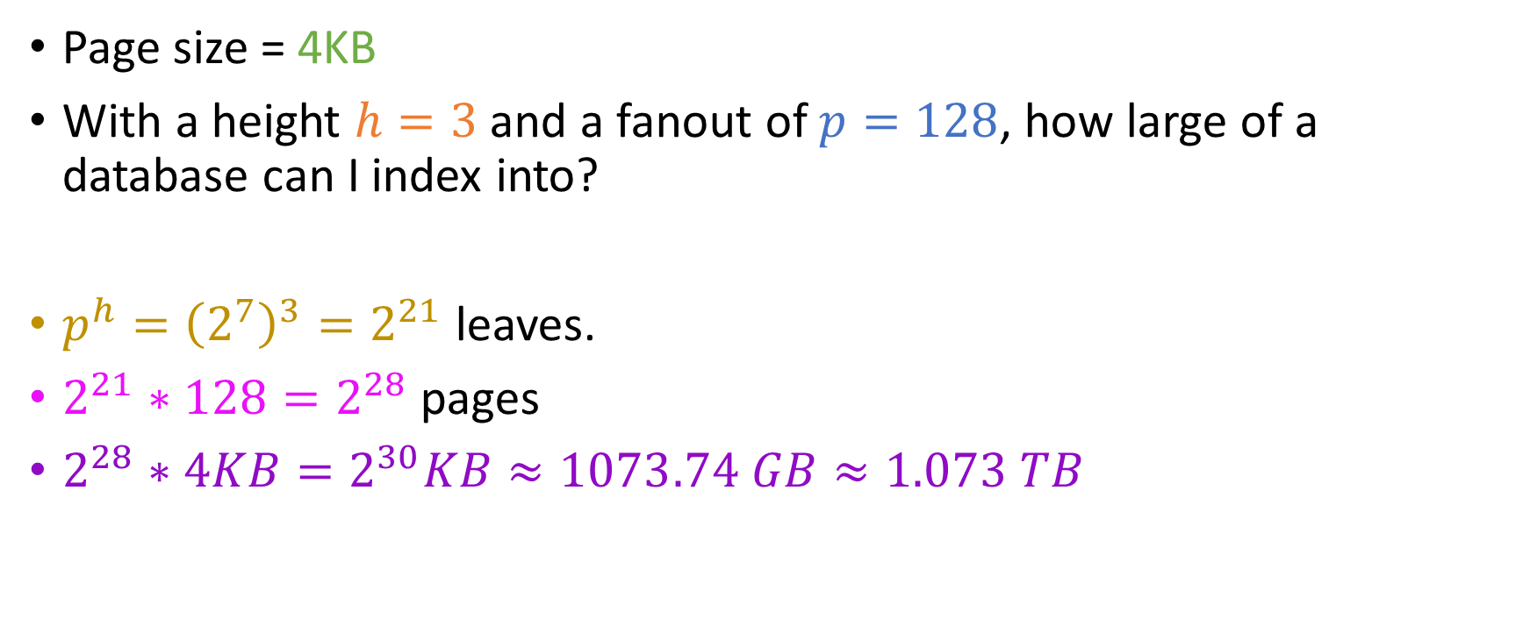
Similar exercise
Page size = 4KB
With a height $h=3$ and a fanout of $p=128$, how large of a database can I index into?
$p^{h}={\left(2^{7}\right)}^{3}=2^{21}$ leaves.
$2^{21}∗128=2^{28}$ pages
$2^{28}∗4KB=2^{30}KB≈1073.74 GB≈1.073 TB$

Slide 60
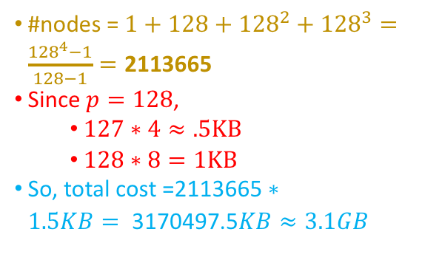
Similar exercise
Page size = 4KB
With a height $h=3$ and a fanout of $p=128$, how large of a database can I index into?
$p^{h}={\left(2^{7}\right)}^{3}=2^{21}$ leaves.
$2^{21}∗128=2^{28}$ pages
$2^{28}∗4KB=2^{30}KB≈1073.74 GB≈1.073 TB$
#nodes = $1+128+{128}^{2}+128^{3}=\frac{{128}^{4}−1}{128−1}=\text{2113665}$
Since $p=128$,
$127∗4≈.5KB$
$128∗8=1KB$
So, total cost =$\text{2113665}∗1.5KB=\text{ 3170497.5}KB≈3.1GB$

Slide 61

Similar exercise
Page size = 4KB
With a height $h=3$ and a fanout of $p=128$, how large of a database can I index into?
$p^{h}={\left(2^{7}\right)}^{3}=2^{21}$ leaves.
$2^{21}∗128=2^{28}$ pages
$2^{28}∗4KB=2^{30}KB≈1073.74 GB≈1.073 TB$
#nodes = $1+128+{128}^{2}+128^{3}=\frac{{128}^{4}−1}{128−1}=\text{2113665}$
Since $p=128$,
$127∗4≈.5KB$
$128∗8=1KB$
So, total cost =$\text{2113665}∗1.5KB=\text{ 3170497.5}KB≈3.1GB$
0.289% of DB SIZE!!

Slide 62

Thought experiment
For the same size DB, what would the size of a BST-based index be?

Slide 63
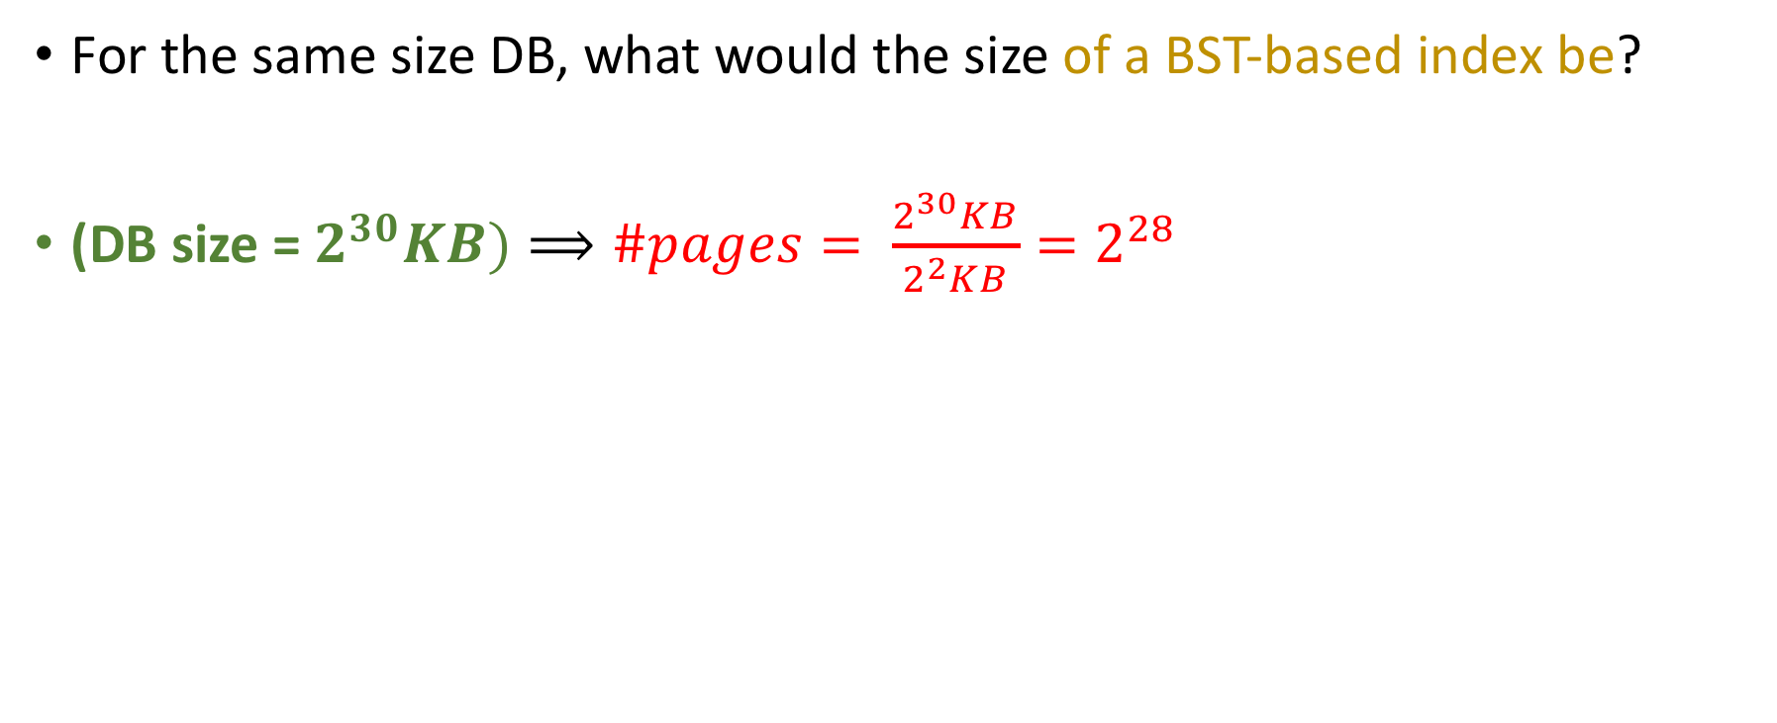
Thought experiment
For the same size DB, what would the size of a BST-based index be?
(DB size = $2^{30}KB)⟹\#pages= \frac{2^{30}KB}{2^{2}KB}=2^{28}$

Slide 64
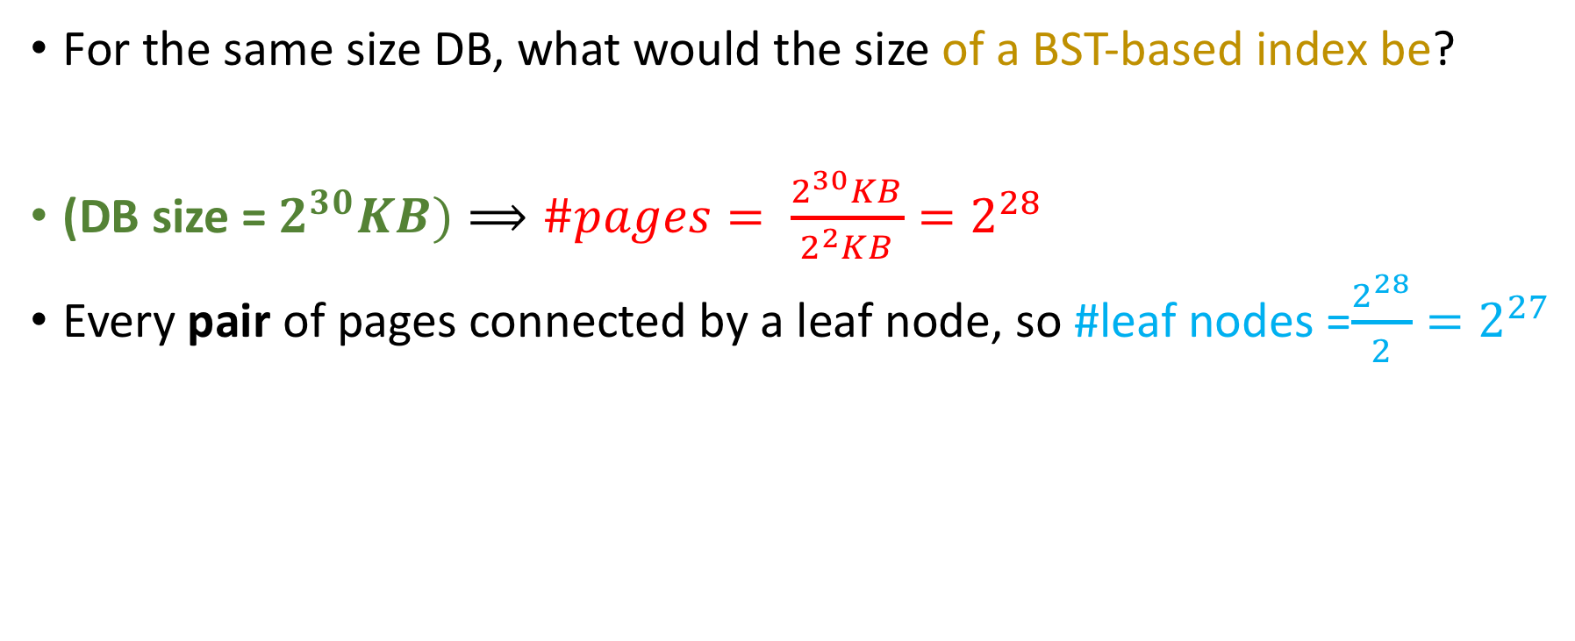
Thought experiment
For the same size DB, what would the size of a BST-based index be?
(DB size = $2^{30}KB)⟹\#pages= \frac{2^{30}KB}{2^{2}KB}=2^{28}$
Every pair of pages connected by a leaf node, so #leaf nodes =$\frac{2^{28}}{2}=2^{27}$

Slide 65
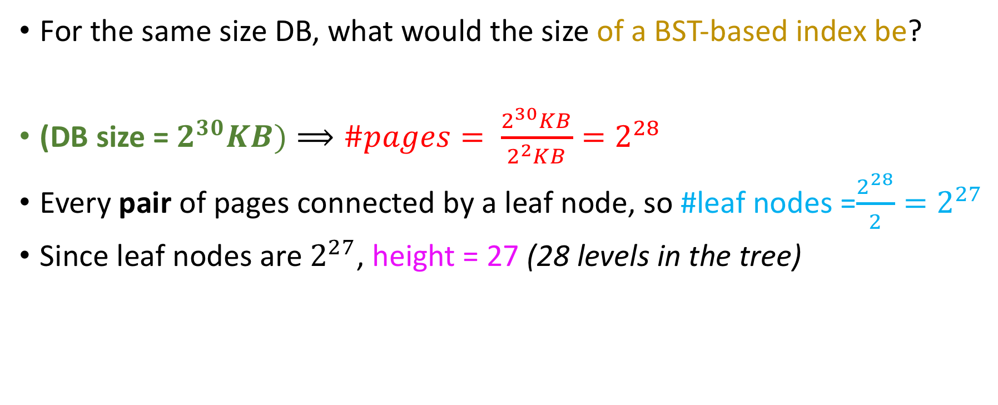
Thought experiment
For the same size DB, what would the size of a BST-based index be?
(DB size = $2^{30}KB)⟹\#pages= \frac{2^{30}KB}{2^{2}KB}=2^{28}$
Every pair of pages connected by a leaf node, so #leaf nodes =$\frac{2^{28}}{2}=2^{27}$
Since leaf nodes are $2^{27}$, height = 27 (28 levels in the tree)

Slide 66
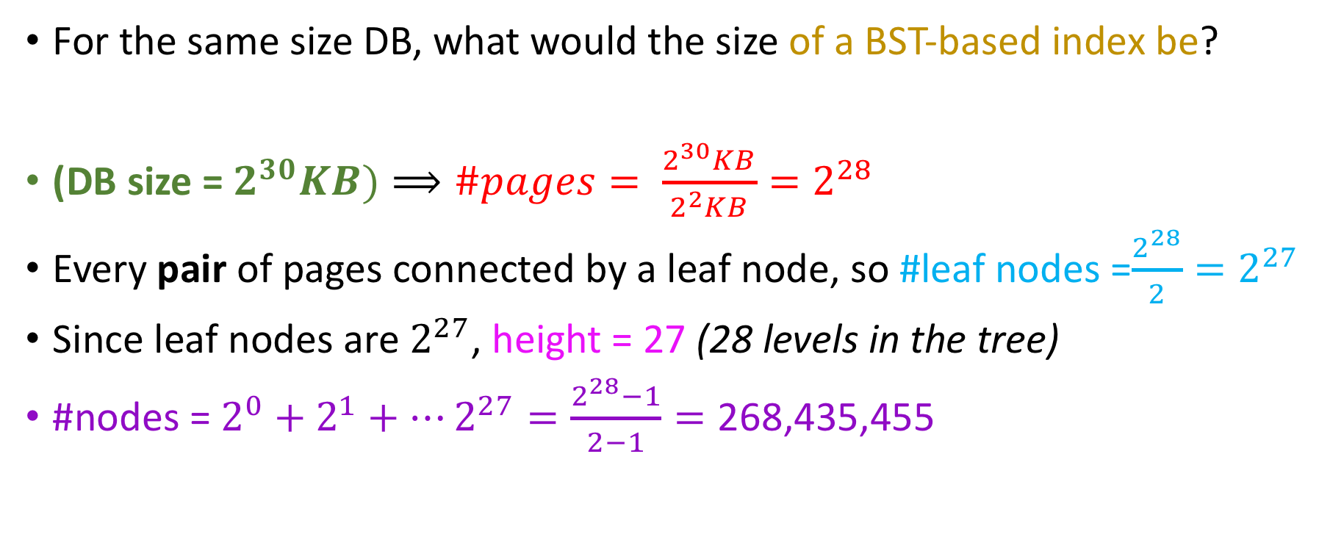
Thought experiment
For the same size DB, what would the size of a BST-based index be?
(DB size = $2^{30}KB)⟹\#pages= \frac{2^{30}KB}{2^{2}KB}=2^{28}$
Every pair of pages connected by a leaf node, so #leaf nodes =$\frac{2^{28}}{2}=2^{27}$
Since leaf nodes are $2^{27}$, height = 27 (28 levels in the tree)
#nodes = $2^{0}+2^{1}+…2^{27}=\frac{2^{28}−1}{2−1}=\text{268}\text{,}\text{435}\text{,}\text{455}$

Slide 67
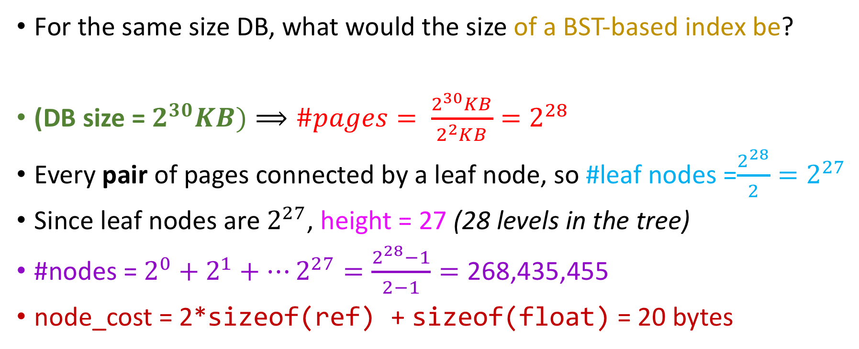
Thought experiment
For the same size DB, what would the size of a BST-based index be?
(DB size = $2^{30}KB)⟹\#pages= \frac{2^{30}KB}{2^{2}KB}=2^{28}$
Every pair of pages connected by a leaf node, so #leaf nodes =$\frac{2^{28}}{2}=2^{27}$
Since leaf nodes are $2^{27}$, height = 27 (28 levels in the tree)
#nodes = $2^{0}+2^{1}+…2^{27}=\frac{2^{28}−1}{2−1}=\text{268}\text{,}\text{435}\text{,}\text{455}$
node_cost = 2*sizeof(ref) + sizeof(float) = 20 bytes

Slide 68

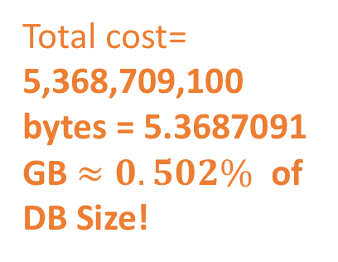
Thought experiment
For the same size DB, what would the size of a BST-based index be?
(DB size = $2^{30}KB)⟹\#pages= \frac{2^{30}KB}{2^{2}KB}=2^{28}$
Every pair of pages connected by a leaf node, so #leaf nodes =$\frac{2^{28}}{2}=2^{27}$
Since leaf nodes are $2^{27}$, height = 27 (28 levels in the tree)
#nodes = $2^{0}+2^{1}+…2^{27}=\frac{2^{28}−1}{2−1}=\text{268}\text{,}\text{435}\text{,}\text{455}$
node_cost = 2*sizeof(ref) + sizeof(float) = 20 bytes
Total cost= 5,368,709,100 bytes = 5.3687091 GB $≈0.502\%$ of DB Size!

Slide 69
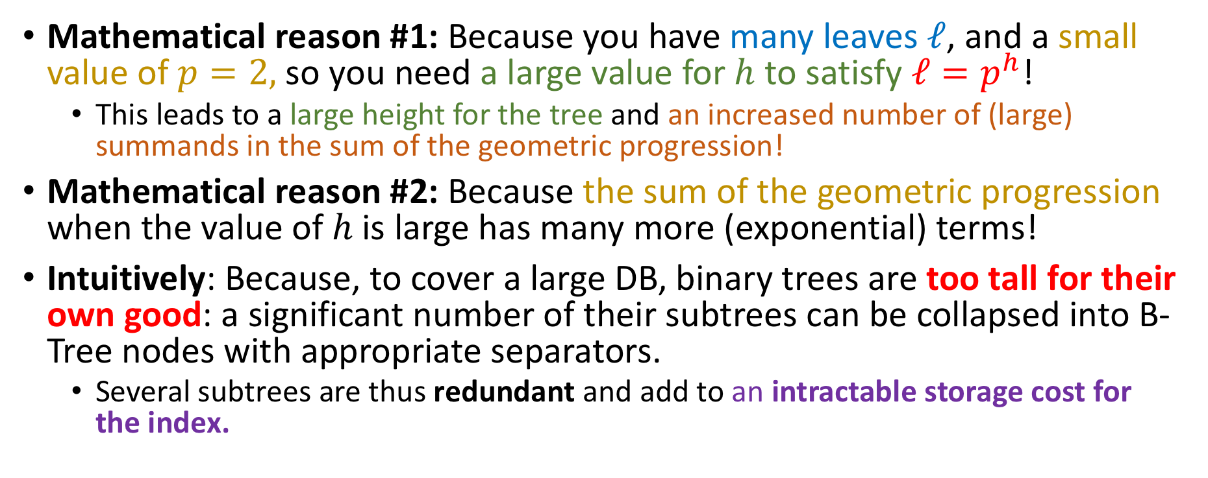
So why does this happen?
Mathematical reason #1: Because you have many leaves $ℓ$, and a small value of $p=2,$ so you need a large value for $h$ to satisfy $ℓ=p^{h}$!
This leads to a large height for the tree and an increased number of (large) summands in the sum of the geometric progression!
Mathematical reason #2: Because the sum of the geometric progression when the value of $h$ is large has many more (exponential) terms!
Intuitively: Because, to cover a large DB, binary trees are too tall for their own good: a significant number of their subtrees can be collapsed into B-Tree nodes with appropriate separators.
Several subtrees are thus redundant and add to an intractable storage cost for the index.

Slide 70
Mnemonic rule
When indexing into a large DB….

Slide 71

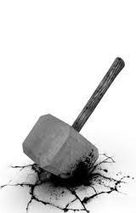

Mnemonic rule
When indexing into a large DB….
Go short and fat!

Slide 72
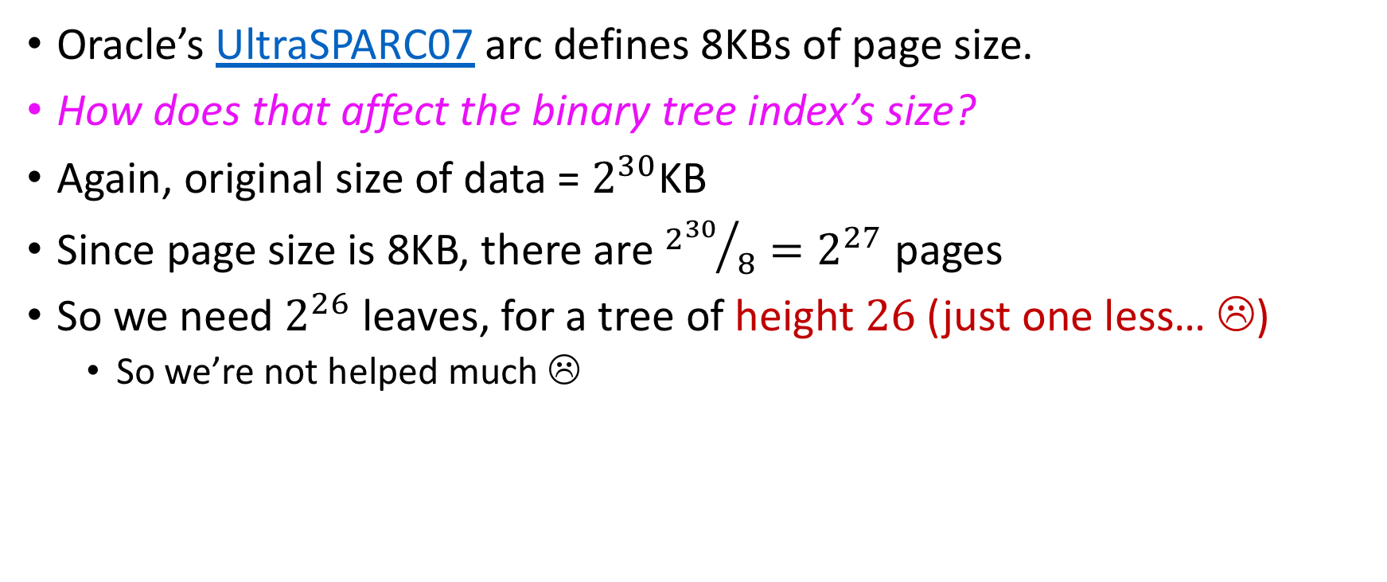
What about different page sizes?
Oracle’s UltraSPARC07 arc defines 8KBs of page size.
How does that affect the binary tree index’s size?
Again, original size of data = $2^{30}$KB
Since page size is 8KB, there are ${2^{30}}/8=2^{27}$ pages
So we need $2^{26}$ leaves, for a tree of height $26$ (just one less… ☹)
So we’re not helped much ☹

Slide 73
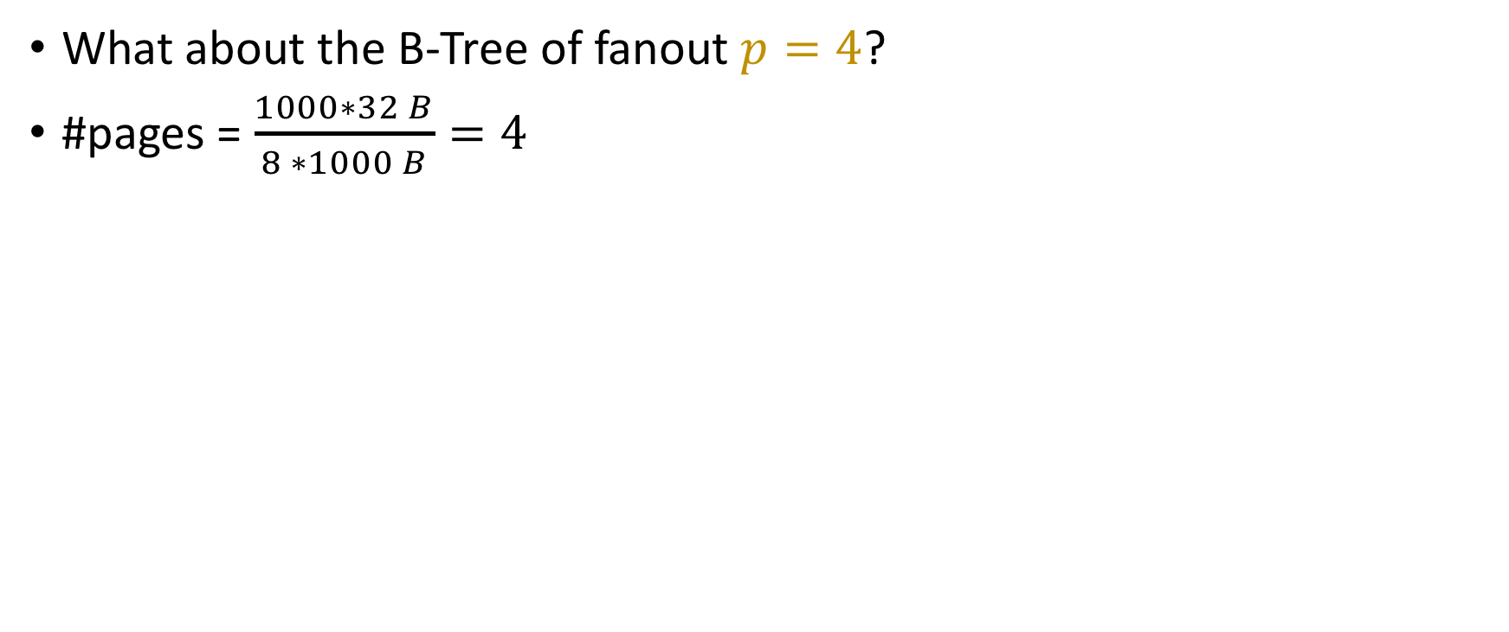
What about different page sizes?
What about the B-Tree of fanout $p=4$?
#pages = $\frac{1000∗32 B}{8 ∗1000 B}=4$

Slide 74
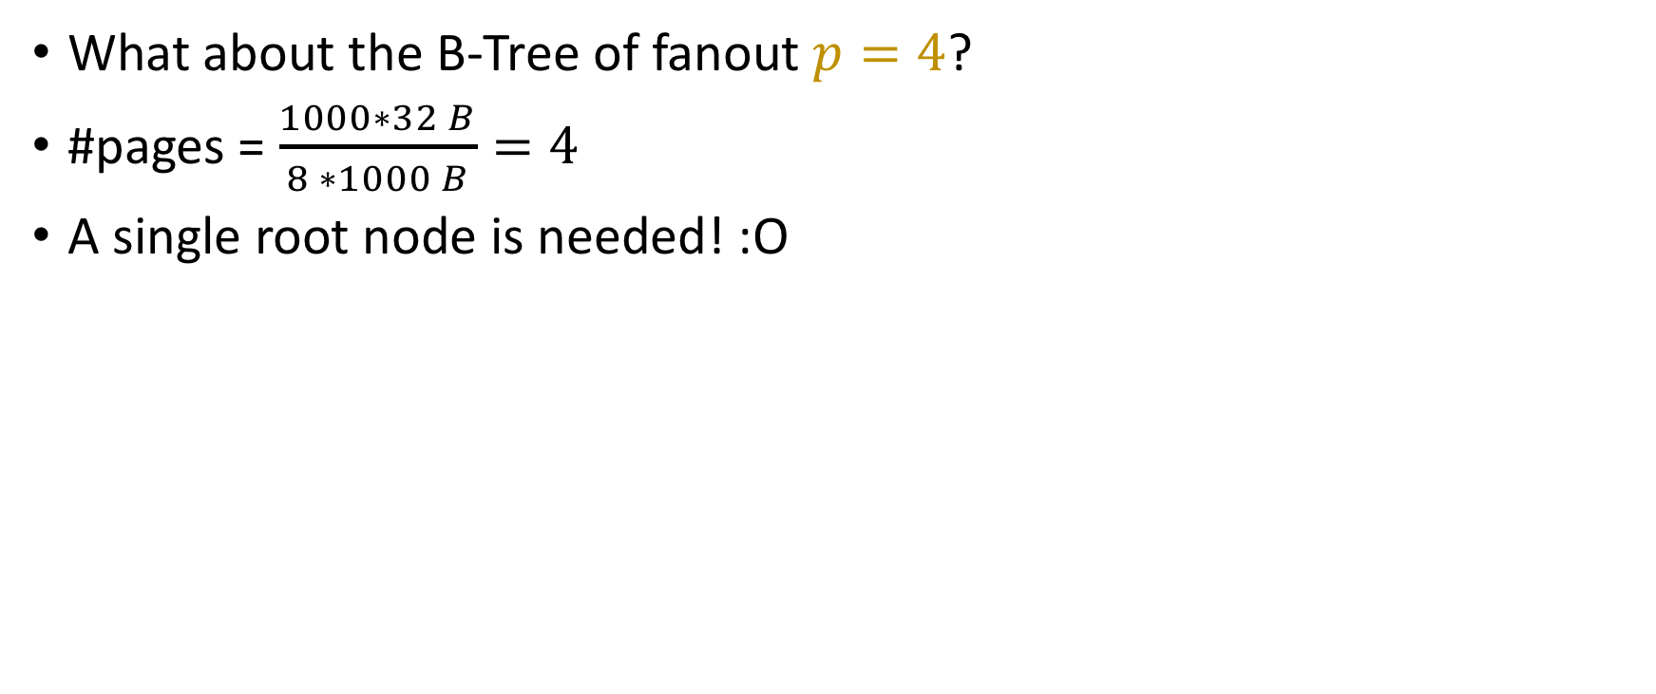
What about different page sizes?
What about the B-Tree of fanout $p=4$?
#pages = $\frac{1000∗32 B}{8 ∗1000 B}=4$
A single root node is needed! :O
256.5 | 512.5 | 768.5
* | * | * | *
0 …… 256
257 … … 512
513 …. 768
769 …. 1024

Slide 75
What about different page sizes?
What about the B-Tree of fanout $p=4$?
#pages = $\frac{1000∗32 B}{8 ∗1000 B}=4$
A single root node is needed! :O
Memory cost = 3 * sizeof(float) + 4*sizeof(ref) = 44 bytes = 0.1375% of DB size
256.5 | 512.5 | 768.5
* | * | * | *
0 …… 256
257 … … 512
513 …. 768
769 …. 1024

Slide 76
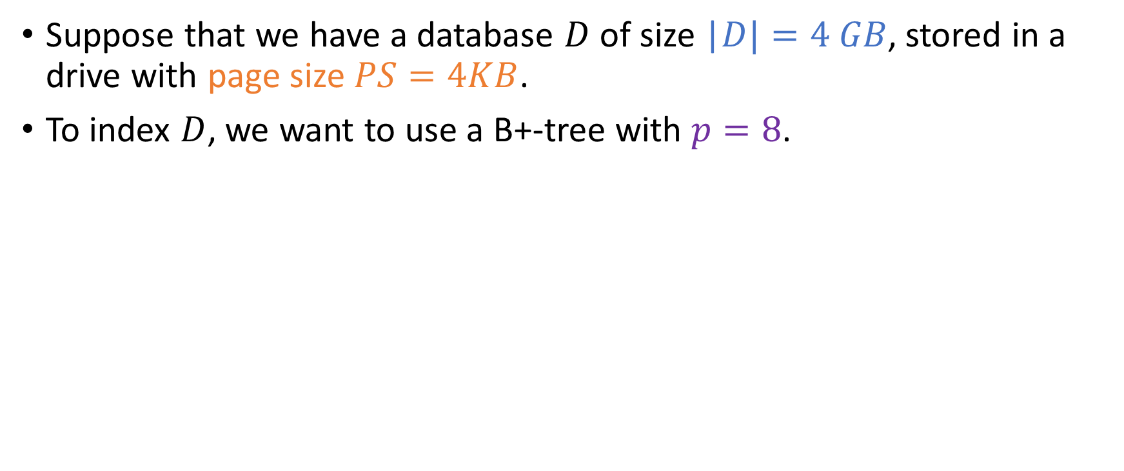
Deciding on fan-out and height
Suppose that we have a database $D$ of size |$D|=4 GB$, stored in a drive with page size $PS=4KB$.
To index $D$, we want to use a B+-tree with $p=8$.

Slide 77
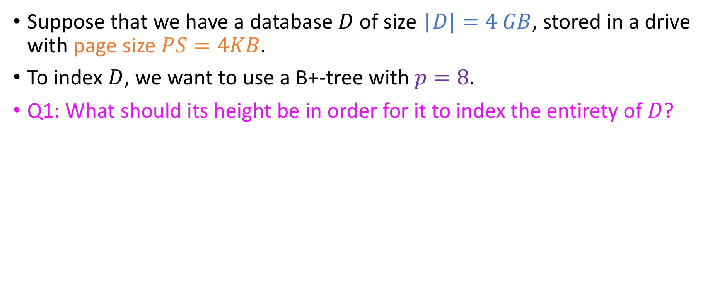
Deciding on fan-out and height
Suppose that we have a database $D$ of size |$D|=4 GB$, stored in a drive with page size $PS=4KB$.
To index $D$, we want to use a B+-tree with $p=8$.
Q1: What should its height be in order for it to index the entirety of $D$?

Slide 78
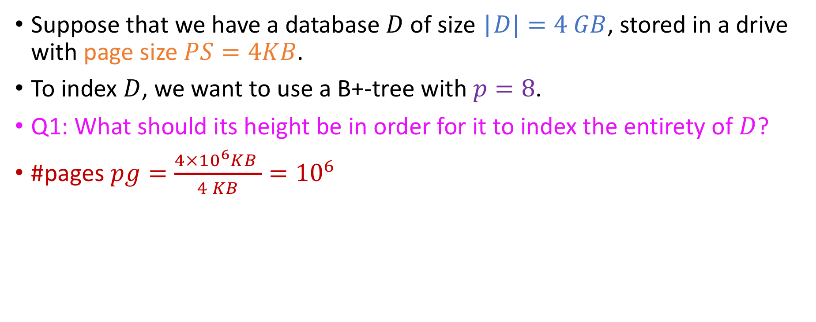
Deciding on fan-out and height
Suppose that we have a database $D$ of size |$D|=4 GB$, stored in a drive with page size $PS=4KB$.
To index $D$, we want to use a B+-tree with $p=8$.
Q1: What should its height be in order for it to index the entirety of $D$?
#pages $pg=\frac{4×{10}^{6}KB }{4 KB}={10}^{6}$

Slide 79
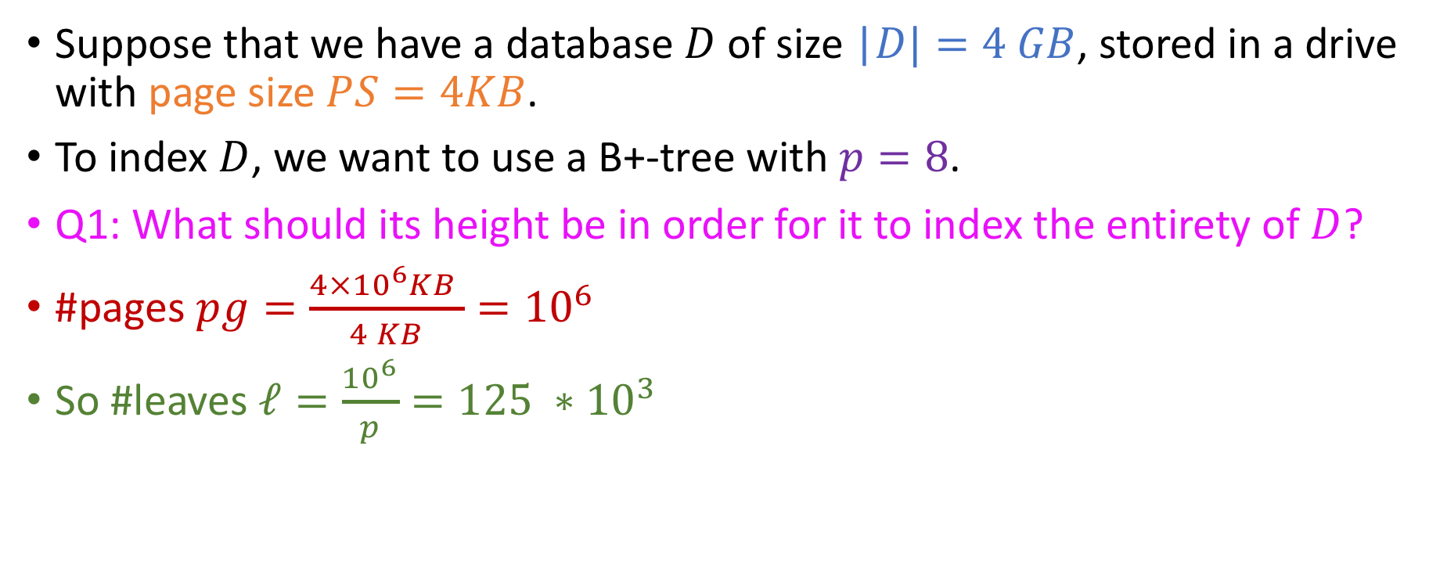
Deciding on fan-out and height
Suppose that we have a database $D$ of size |$D|=4 GB$, stored in a drive with page size $PS=4KB$.
To index $D$, we want to use a B+-tree with $p=8$.
Q1: What should its height be in order for it to index the entirety of $D$?
#pages $pg=\frac{4×{10}^{6}KB }{4 KB}={10}^{6}$
So #leaves $ℓ=\frac{{10}^{6}}{p}=125 ∗{10}^{3}$

Slide 80

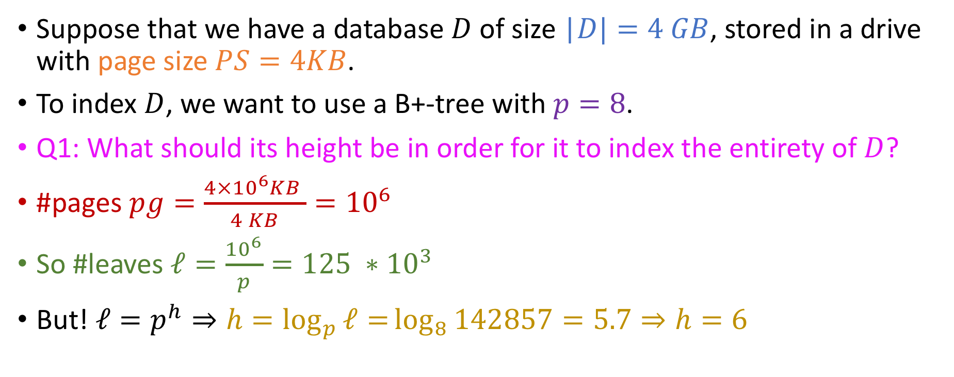
Deciding on fan-out and height
Suppose that we have a database $D$ of size |$D|=4 GB$, stored in a drive with page size $PS=4KB$.
To index $D$, we want to use a B+-tree with $p=8$.
Q1: What should its height be in order for it to index the entirety of $D$?
#pages $pg=\frac{4×{10}^{6}KB }{4 KB}={10}^{6}$
So #leaves $ℓ=\frac{{10}^{6}}{p}=125 ∗{10}^{3}$
But! ${ℓ=p}^{h}⇒h=\log_{p}{ℓ=}\log_{8}{142857}=5.7⇒h=6$

Slide 81
Spatial cost of this index
Q2: What’s the spatial cost of this index?

Slide 82
Spatial cost of this index
Q2: What’s the spatial cost of this index?
Node cost = 4*7 + 8 * 8 =92 bytes

Slide 83
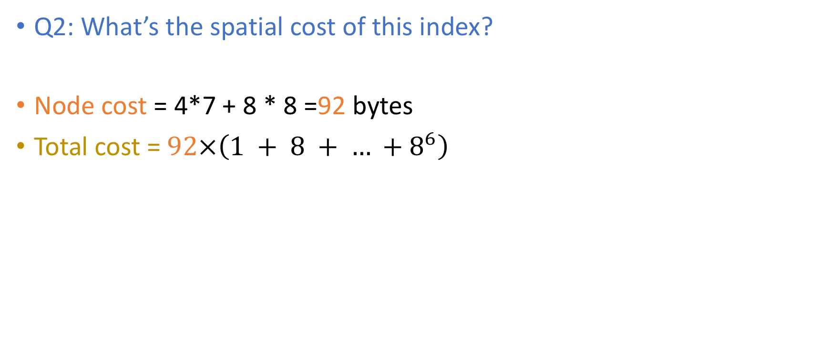
Spatial cost of this index
Q2: What’s the spatial cost of this index?
Node cost = 4*7 + 8 * 8 =92 bytes
Total cost = $92×\left(1 + 8 + … +8^{6}\right)$

Slide 84
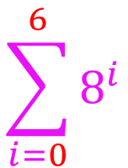
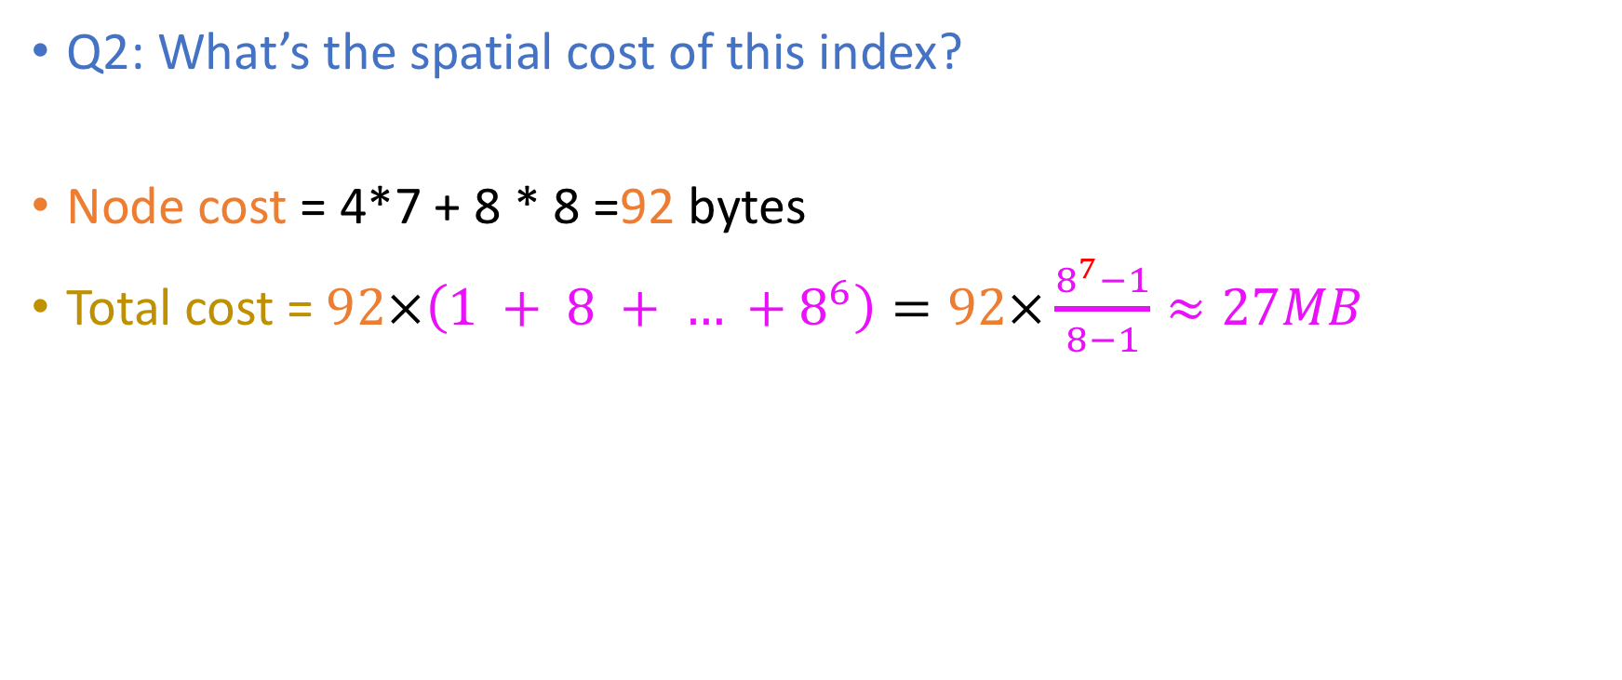
Spatial cost of this index
Q2: What’s the spatial cost of this index?
Node cost = 4*7 + 8 * 8 =92 bytes
Total cost = $92×\left(1 + 8 + … +8^{6}\right)=92×\frac{8^{7}−1}{8−1}≈27MB$
$$\sum_{i=0}^{6}{8^{i}}$$

Slide 85

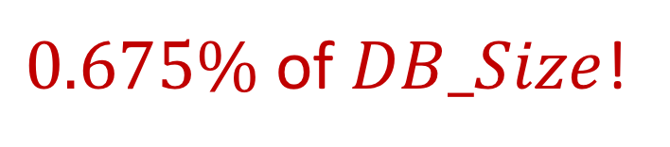
Spatial cost of this index
Q2: What’s the spatial cost of this index?
Node cost = 4*7 + 8 * 8 =92 bytes
Total cost = $92×\left(1 + 8 + … +8^{6}\right)=92×\frac{8^{7}−1}{8−1}≈27MB$
$0.675\%$ of $DB_Size$!
$$\sum_{i=0}^{6}{8^{i}}$$

Slide 86
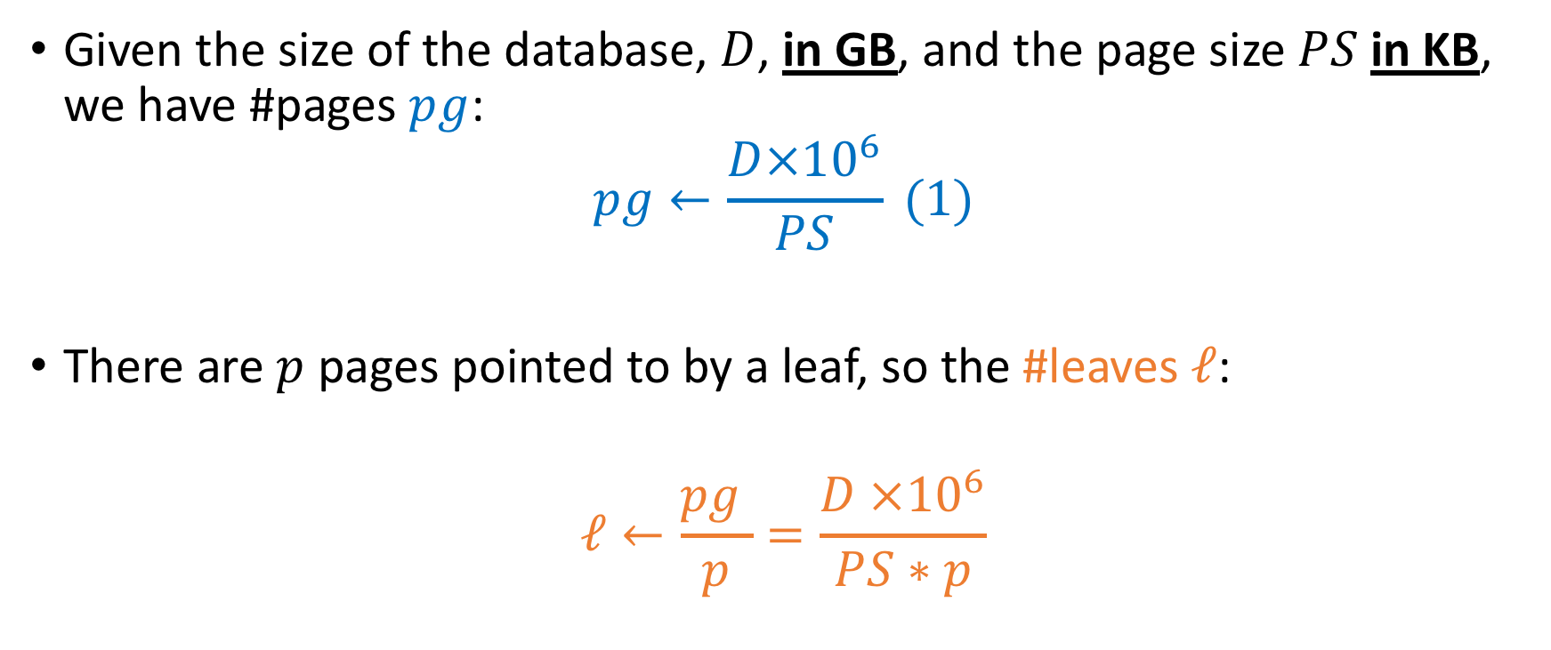


Formulae
Given the size of the database, $D$, in GB, and the page size $PS$in KB, we have #pages $pg$:
$$pg←\frac{D×{10}^{6}}{PS} (1)$$
There are $p$ pages pointed to by a leaf, so the #leaves $ℓ$:
$$ℓ←\frac{pg }{p}=\frac{D ×{10}^{6}}{PS∗p}$$
$$(1)$$
$$(2)$$

Slide 87
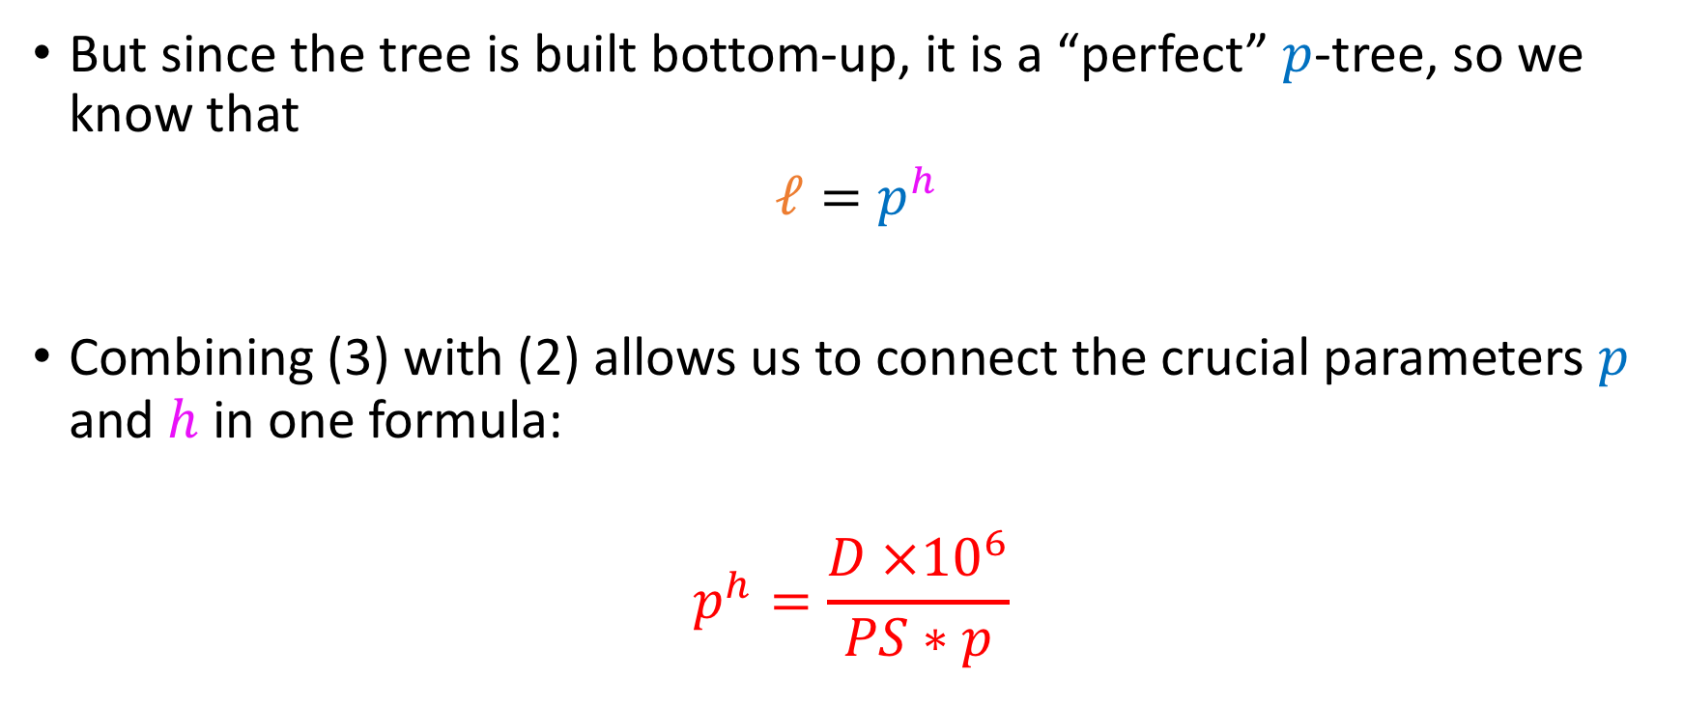
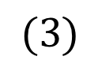
Formulae
But since the tree is built bottom-up, it is a “perfect” $p$-tree, so we know that
$ℓ=p^{h}$
Combining (3) with (2) allows us to connect the crucial parameters $p$ and $h$ in one formula:
$$p^{h}=\frac{D ×{10}^{6}}{PS∗p}$$
$$(3)$$

Slide 88
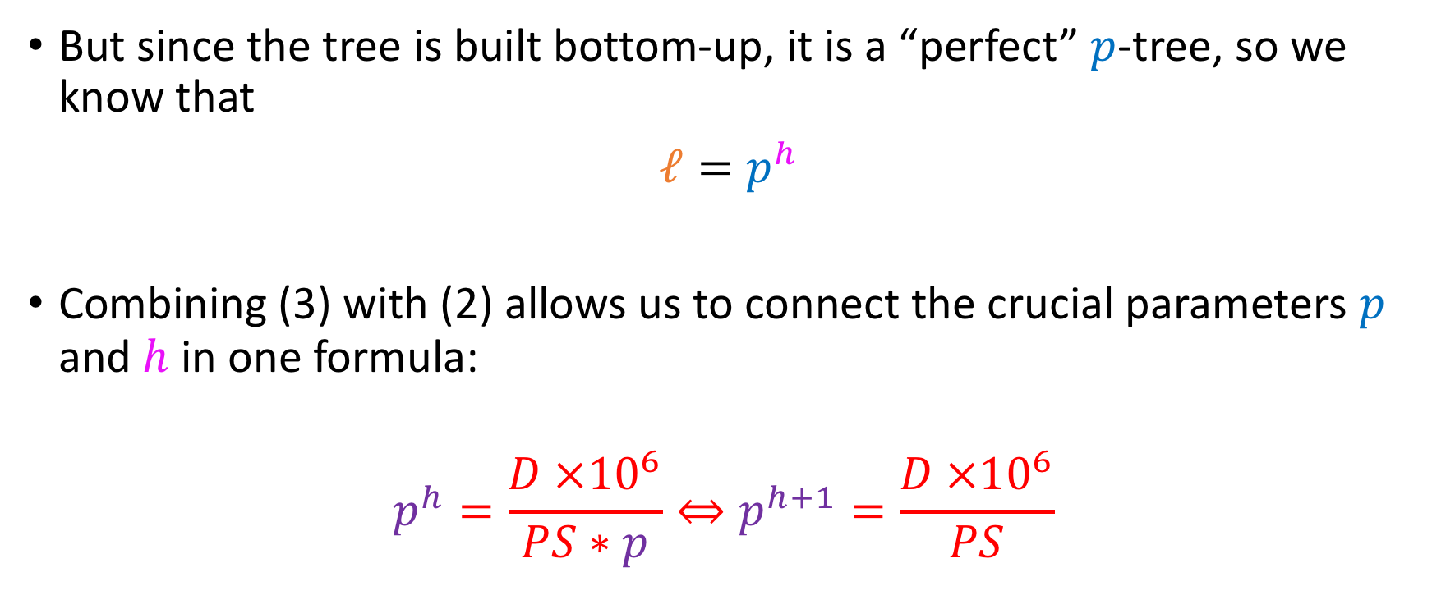
Formulae
But since the tree is built bottom-up, it is a “perfect” $p$-tree, so we know that
$ℓ=p^{h}$
Combining (3) with (2) allows us to connect the crucial parameters $p$ and $h$ in one formula:
$$p^{h}=\frac{D ×{10}^{6}}{PS∗p}⇔p^{h+1}=\frac{D ×{10}^{6}}{PS}$$
$$(3)$$

Slide 89
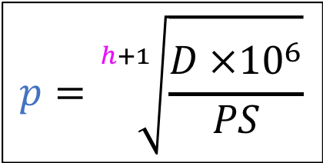
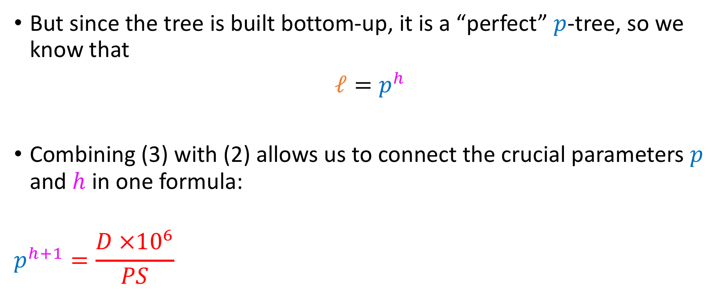
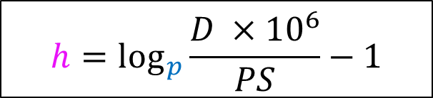


Formulae
But since the tree is built bottom-up, it is a “perfect” $p$-tree, so we know that
$ℓ=p^{h}$
Combining (3) with (2) allows us to connect the crucial parameters $p$ and $h$ in one formula:
$$p^{h+1}=\frac{D ×{10}^{6}}{PS}$$
$$(3)$$
$$h=\log_{p}{\frac{D ×{10}^{6}}{PS}}−1$$
Given $p$
$$p=\sqrt[h+1]{\frac{D ×{10}^{6}}{PS}}$$
Given $h$

Slide 90
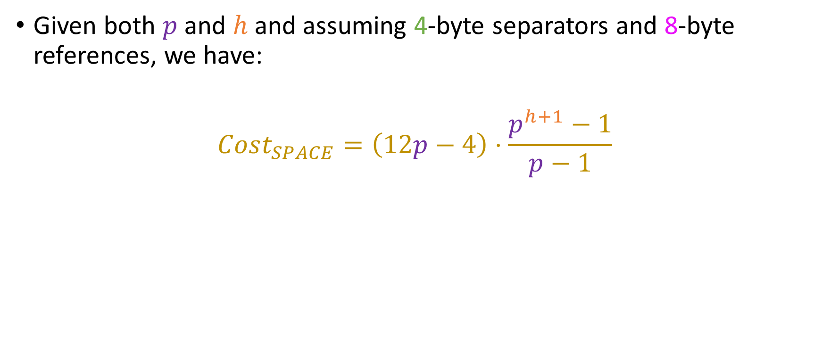
Formulae
Given both $p$ and $h$ and assuming 4-byte separators and 8-byte references, we have:
$$Cost_{SPACE}=\left(12p−4\right)⋅\frac{p^{h+1}−1}{p−1}$$

Slide 91
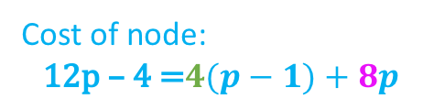
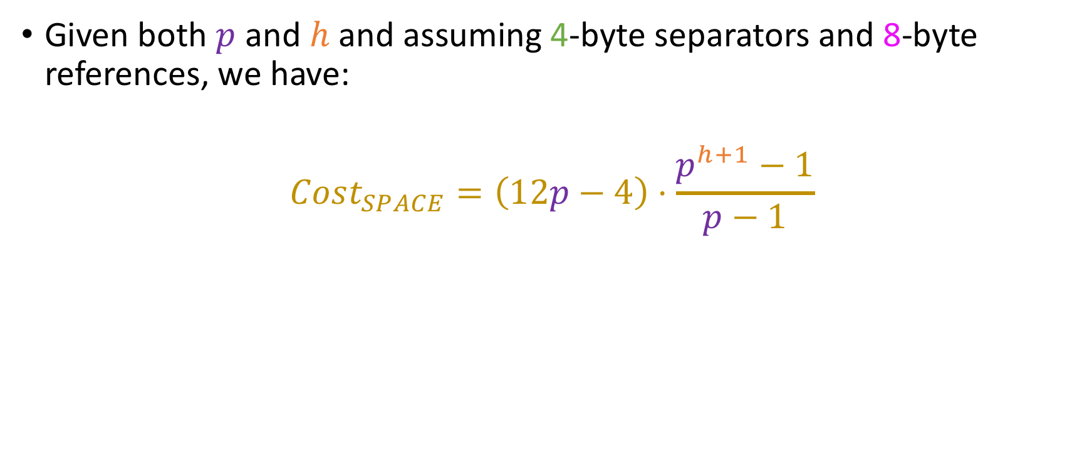
Formulae
Given both $p$ and $h$ and assuming 4-byte separators and 8-byte references, we have:
$$Cost_{SPACE}=\left(12p−4\right)⋅\frac{p^{h+1}−1}{p−1}$$
Cost of node:
$$\text{12}\text{p}\text{ – 4 =}4(p−1)+8p$$
Number of nodes: Sum of geometric progression

Slide 92
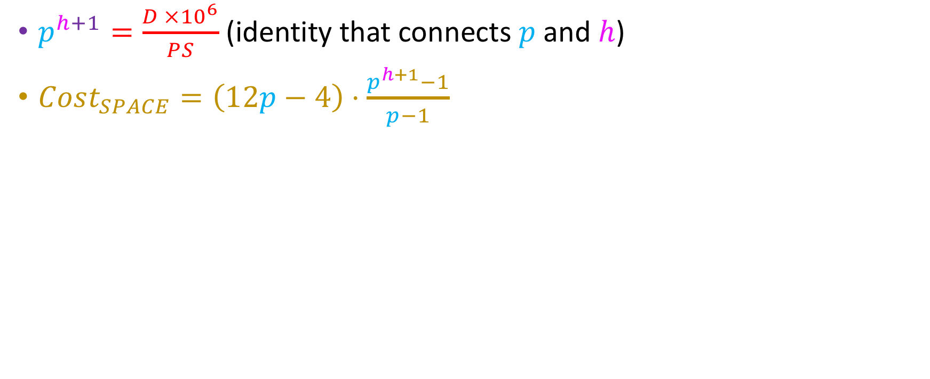
Applying our formulae
$p^{h+1}=\frac{D ×{10}^{6}}{PS}$ (identity that connects $p$ and $h$)
$Cost_{SPACE}=\left(12p−4\right)⋅\frac{p^{h+1}−1}{p−1}$

Slide 93
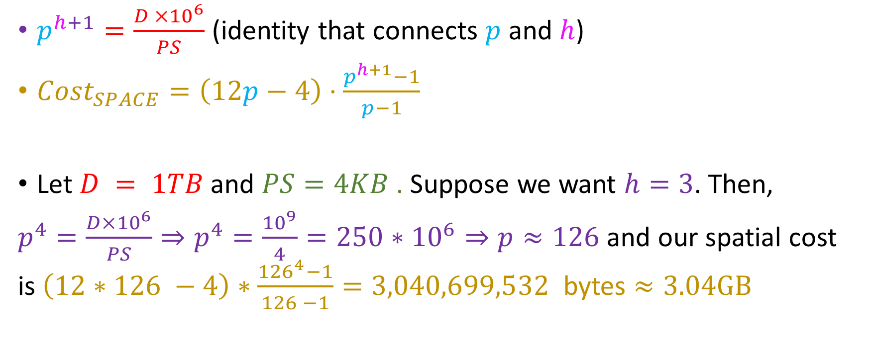
Applying our formulae
$p^{h+1}=\frac{D ×{10}^{6}}{PS}$ (identity that connects $p$ and $h$)
$Cost_{SPACE}=\left(12p−4\right)⋅\frac{p^{h+1}−1}{p−1}$
Let $D = 1TB$ and $PS=4KB$ . Suppose we want $h=3$. Then,
$p^{4}=\frac{D×{10}^{6}}{PS}⇒p^{4}=\frac{{10}^{9}}{4}=250∗{10}^{6}⇒p≈126$ and our spatial cost is $\left(12∗126 −4\right)∗\frac{{126}^{4}−1}{126 −1}=\text{3,040,699,532}$ bytes $≈3.04GB$

Slide 94


Applying our formulae
$p^{h+1}=\frac{D ×{10}^{6}}{PS}$ (identity that connects $p$ and $h$)
$Cost_{SPACE}=\left(12p−4\right)⋅\frac{p^{h+1}−1}{p−1}$
Let $D = 1TB$ and $PS=4KB$ . Suppose we want $h=3$. Then,
$p^{4}=\frac{D×{10}^{6}}{PS}⇒p^{4}=\frac{{10}^{9}}{4}=250∗{10}^{6}⇒p≈126$ and our spatial cost is $\left(12∗126 −4\right)∗\frac{{126}^{4}−1}{126 −1}=\text{3,040,699,532}$ bytes $≈3.04GB$=0.304% of DB size!

Slide 95

Applying our formulae
$p^{h+1}=\frac{D ×{10}^{6}}{PS}$ (identity that connects $p$ and $h$)
$Cost_{SPACE}=\left(12p−4\right)⋅\frac{p^{h+1}−1}{p−1}$
Let $D = 1TB$ and $PS=4KB$ . Suppose now we want $p=64$.

Slide 96

Applying our formulae
$p^{h+1}=\frac{D ×{10}^{6}}{PS}$ (identity that connects $p$ and $h$)
$Cost_{SPACE}=\left(12p−4\right)⋅\frac{p^{h+1}−1}{p−1}$
Let $D = 1TB$ and $PS=4KB$ . Suppose now we want $p=64$. Then,
$h=\log_{64}\left(250 ∗{10}^{6}\right)−1≈3.65⇒h=4$ and our spatial cost is $\left(12∗64 −4\right)∗\frac{{64}^{5}−1}{64 −1}=\text{13}\text{,}\text{021}\text{,}\text{250}\text{,}\text{044}≈13.021GB =1.3\%$ of DB Size ☹

Slide 97

Applying our formulae
$p^{h+1}=\frac{D ×{10}^{6}}{PS}$ (identity that connects $p$ and $h$)
$Cost_{SPACE}=\left(12p−4\right)⋅\frac{p^{h+1}−1}{p−1}$
Let $D = 1TB$ and $PS=4KB$ . Suppose now we want $p=64$. Then,
$h=\log_{64}\left(250 ∗{10}^{6}\right)−1≈3.65⇒h=4$ and our spatial cost is $\left(12∗64 −4\right)∗\frac{{64}^{5}−1}{64 −1}=\text{13}\text{,}\text{021}\text{,}\text{250}\text{,}\text{044}≈13.021GB =1.3\%$ of DB Size ☹
(Expected, the height increased!)

